Slide 1


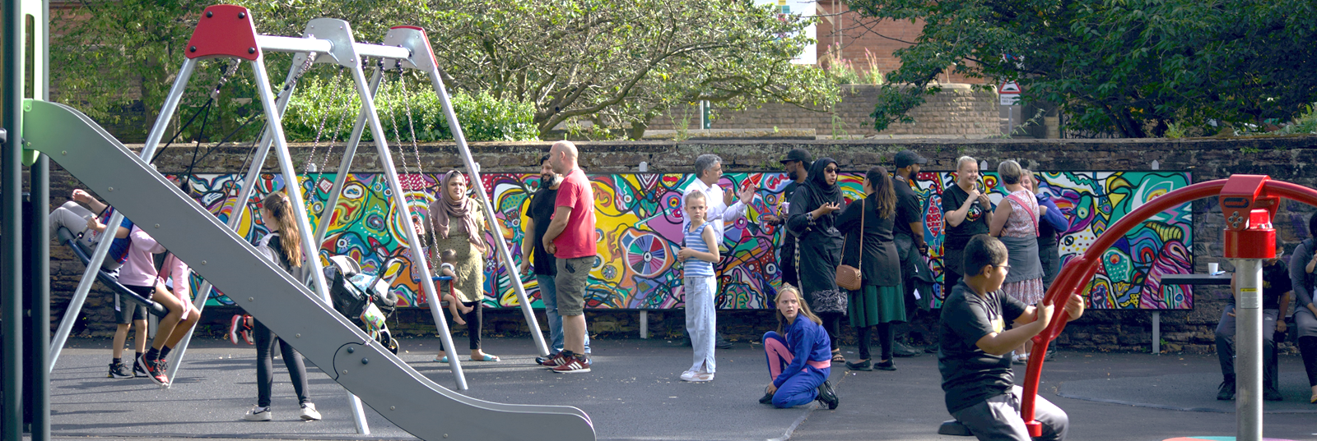
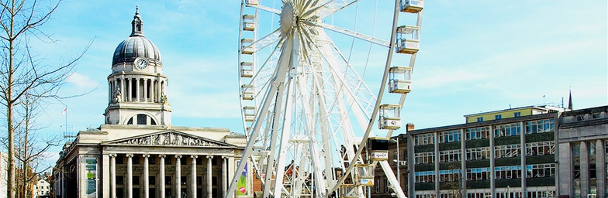

WELCOME
How green infrastructure can reduce health inequality: Nottingham City’s journey towards Nature Towns and Cities Accreditation

Slide 2
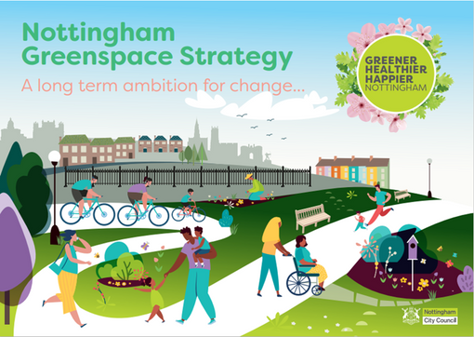

Slide 3
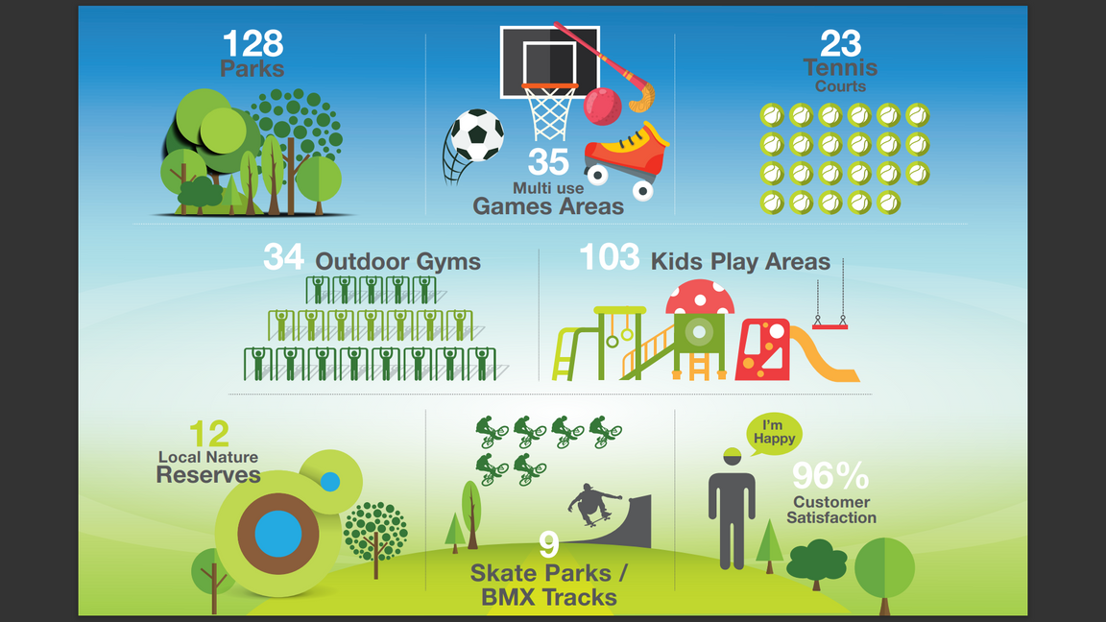

OUR AMAZING GREEN SPACES

Slide 4
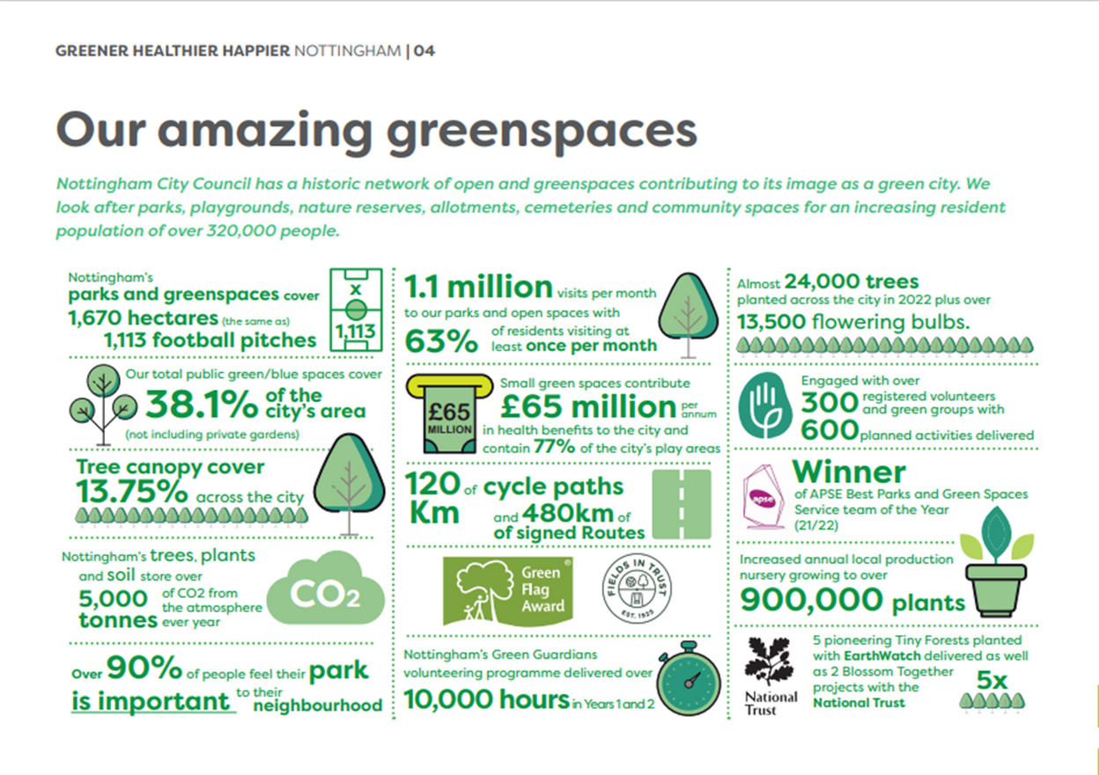
Over 50,000 Trees Planted across the City

Slide 5


STRATEGY CONSULTATION KEY OUTCOMES
Green and Blue space covers 38.1% of the city
There are 1.1 million visits per month to our parks and open spaces
63% of city’s residents visit at least once a month
We look after over 90% of the city’s playgrounds
Over 90% feel their park is important to their neighbourhood with nature, climate and wider environmental benefits considered important

Slide 6
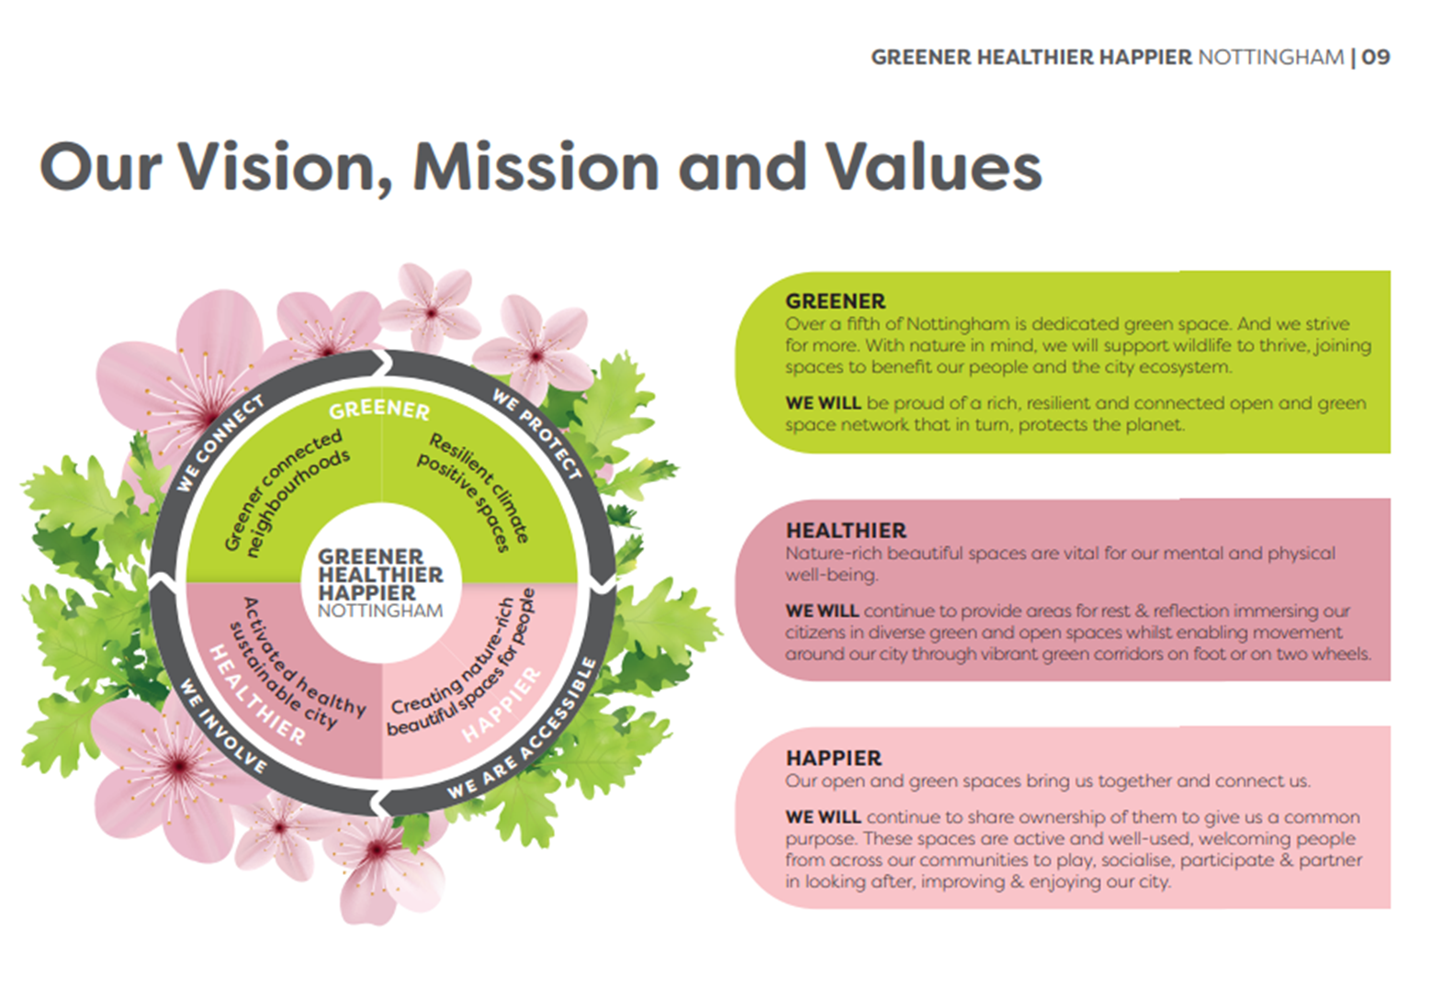

Slide 7
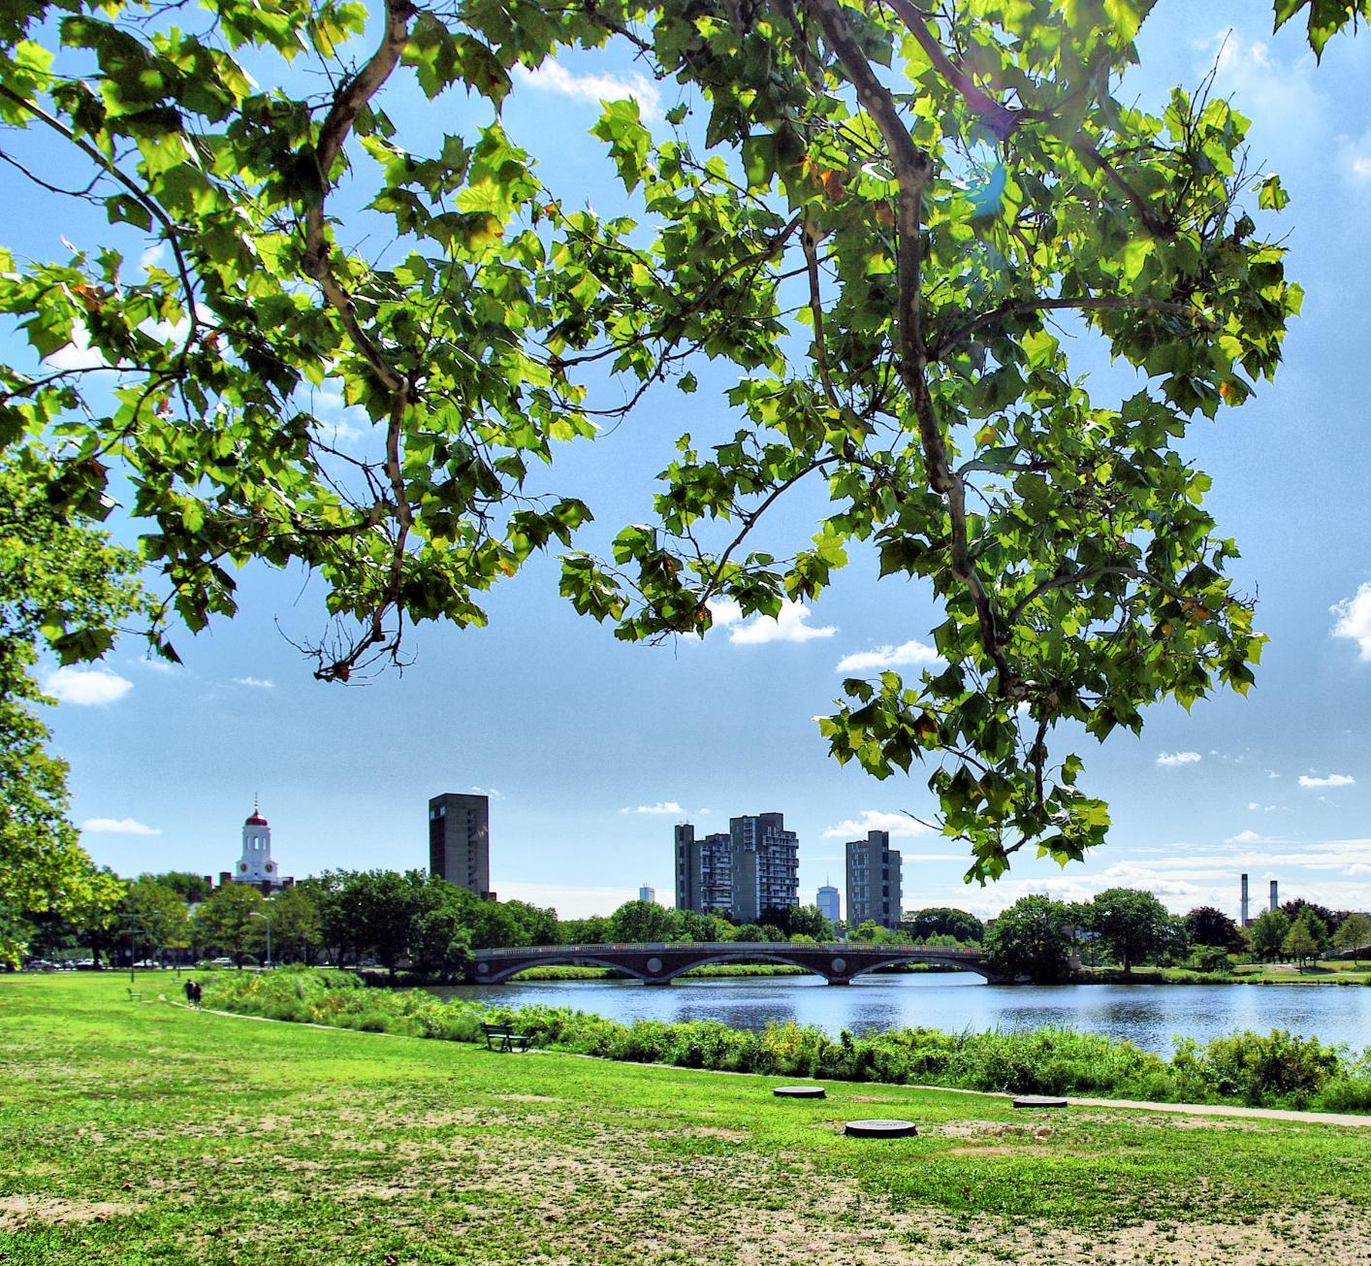
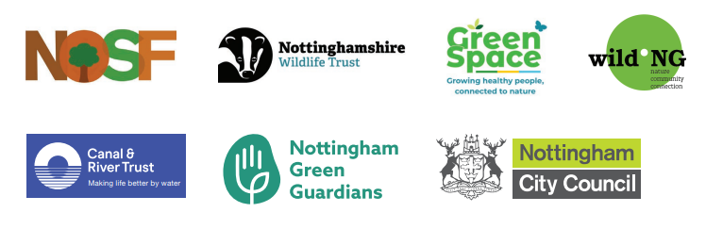
Links to National & Regional Frameworks
National Green/Blue Infrastructure Goals
The strategy aligns with national goals to achieve 40% green and blue urban cover, promoting sustainable city environments.
Nature Towns and Cities
Nottingham’s involvement in the Nature Towns and Cities programme highlights its role in advancing urban greening, community involvement, nature recovery and increasing opportunities for enhancing city-wide biodiversity.
Regional Collaboration
Collaboration with regional authorities enhances Nottingham’s influence on policy, funding, and broader environmental objectives such as the Local Plan & Environment Act
Broader Environmental Impact
Local actions contribute to nature recovery, climate resilience, and improved public health, linking local and regional efforts.

Slide 8
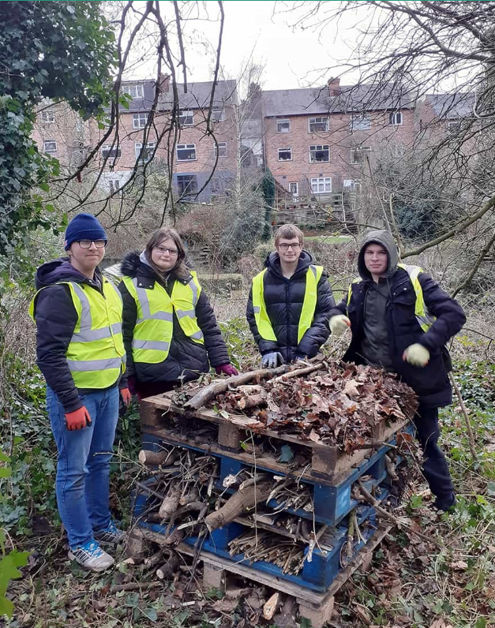
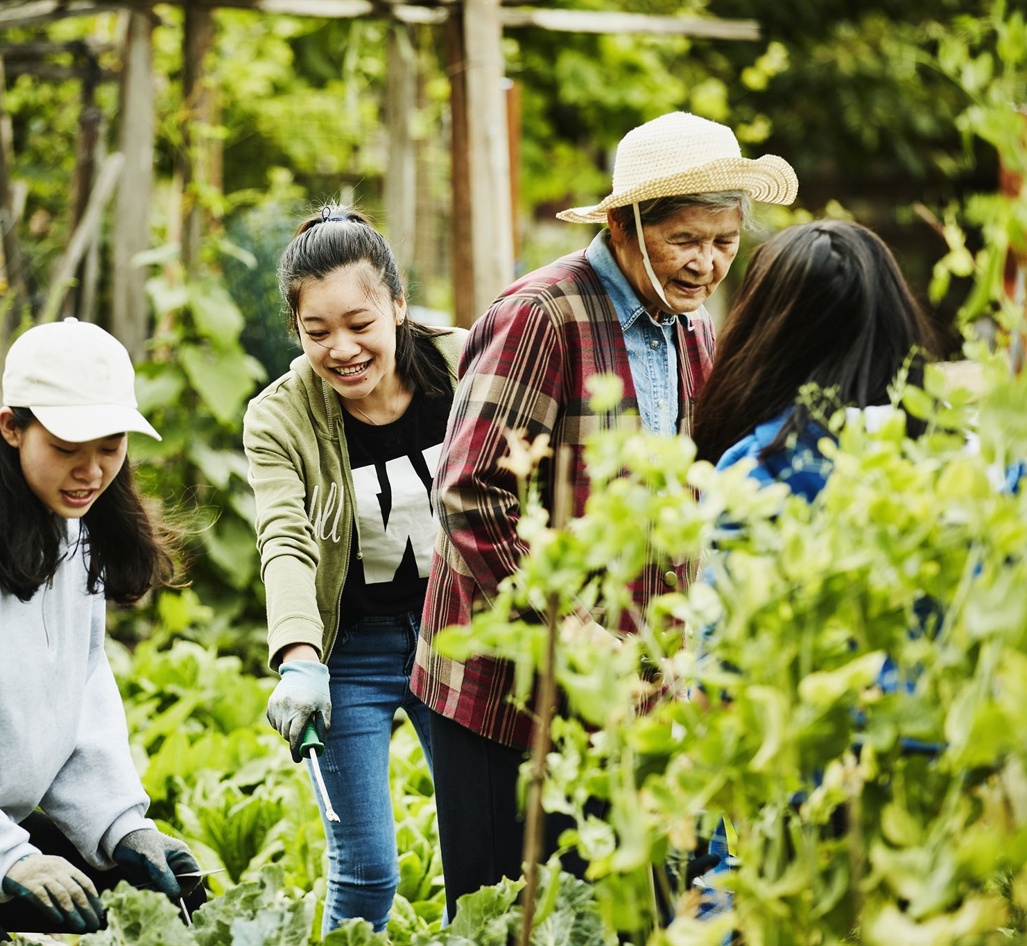

Community Engagement & Partnerships
Green Guardians Volunteer Impact
Over 440 volunteers have contributed to over 50,000 trees planted and habitat creation through the Green Guardians programme.
Friends of Parks & NOSF Collaboration
Friends of Parks groups co-deliver events and support biodiversity projects, fostering local stewardship and pride.
Community Benefits
These programmes improve greenspaces, social connections, mental health, and skill development among participants.
Sustainable Engagement
Volunteer involvement ensures projects meet community needs and remain sustainable beyond initial funding.

Slide 9
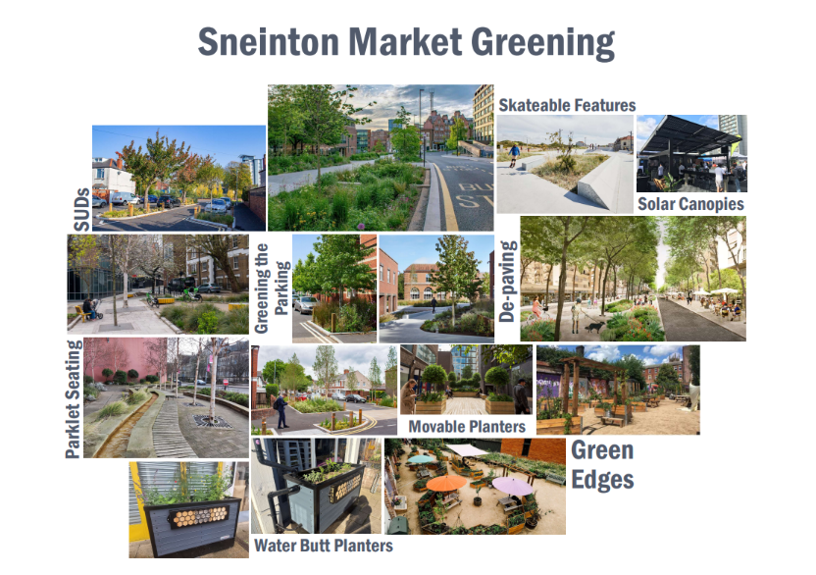

Slide 10
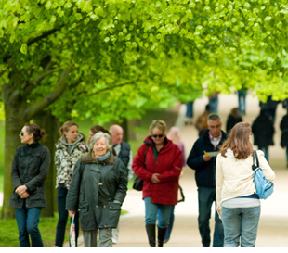
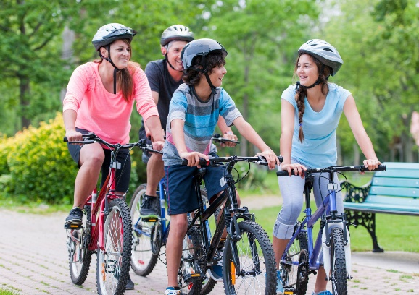
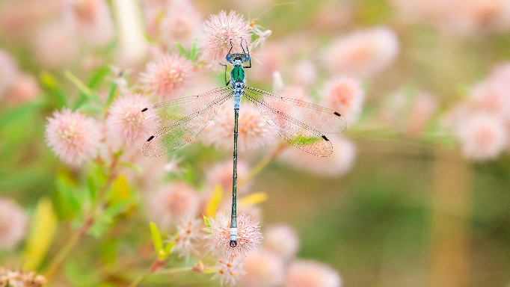



Strategic Integration & Wider Links
Cross-Departmental Integration
The strategy aligns multiple council departments such as Planning, Economic Regeneration, and Public Health through shared goals and common language.
Support for Climate and Biodiversity Goals
It supports the Carbon Neutral 2028 Charter and contributes to biodiversity targets via the Local Nature Recovery Strategy and the Environment Act.
Promotion of Public Health
The strategy promotes active lifestyles by aligning with Nottingham’s Eating & Moving for Good Health policy encouraging accessible greenspaces for health and wellbeing.
Unified Sustainability Approach
Integration ensures greenspace development complements housing, active transport, and health programs creating sustainable community outcomes.

Slide 11
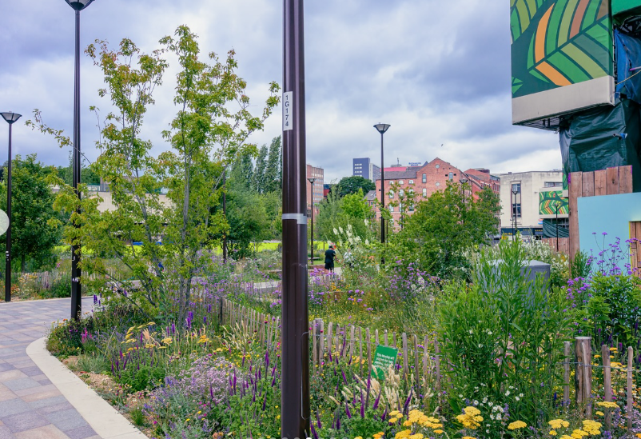
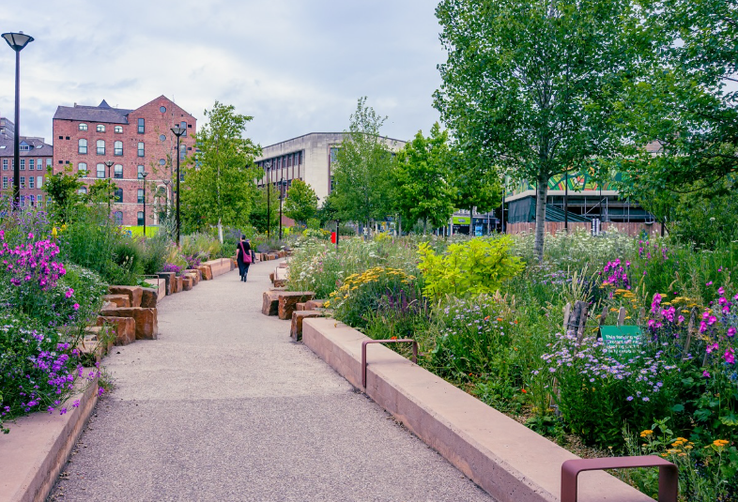
Environmental and Climate Benefits
Tree Planting Initiatives
Increased tree planting continues to improve air quality and enhances biodiversity in our city
Review of Pollinator-Friendly Habitats
A review of nature friendly maintenance and habitats is supporting pollinators, which are vital for ecosystem health and biodiversity.
Sustainable Drainage Systems
Sustainable drainage reduces flood risk and manages stormwater in urban areas effectively such as Haydn Road and sharing of best practice in Mansfield.
Climate-Positive Urban Design
Projects transform urban spaces into nature-rich areas that provide recreation and mitigate environmental risks.

Slide 12
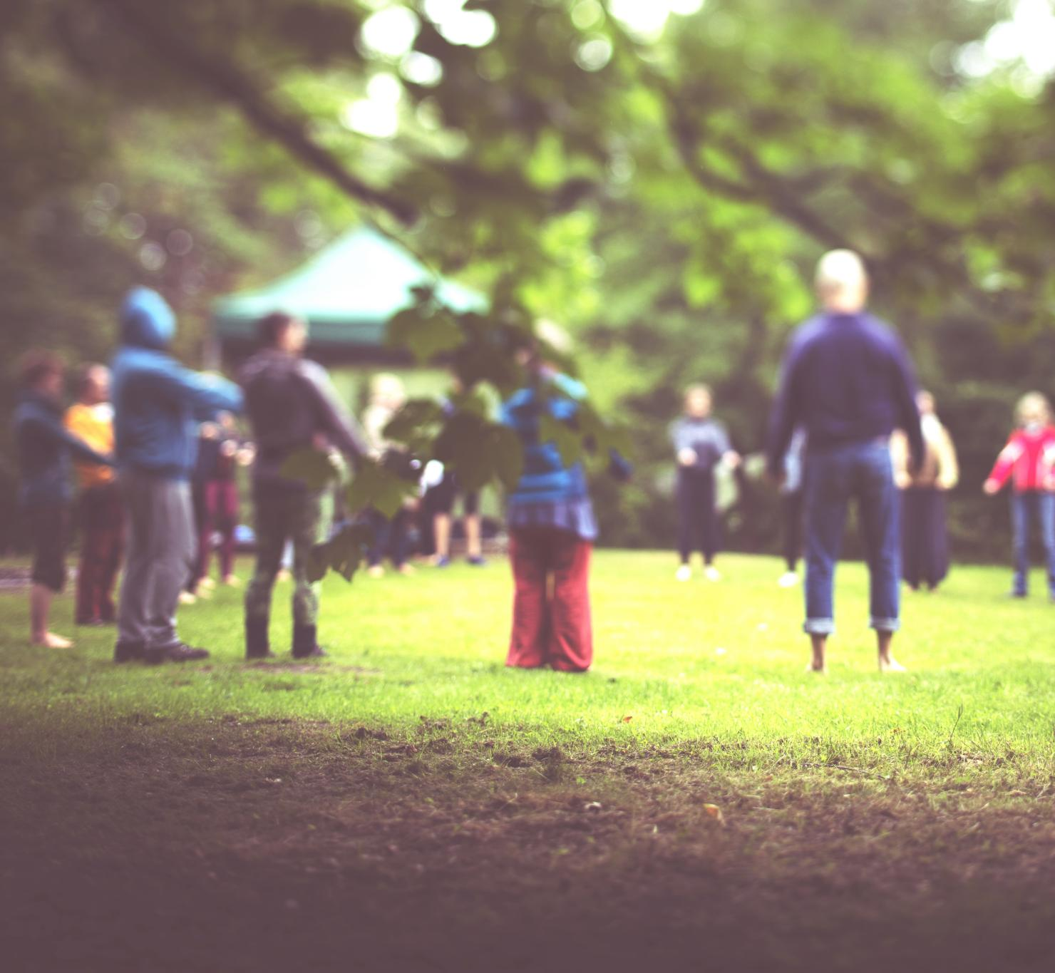
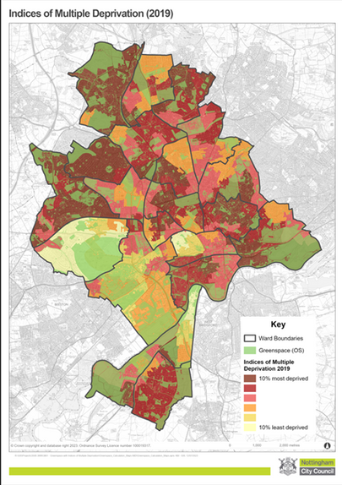


Health, Wellbeing & Social Inclusion
Benefits of Greenspaces
Quality greenspaces continue to encourage physical activity, improve mental health, and foster social connections amongst our city communities. Multiple sports activations continue to provide wide reaching benefits.
Eating and Moving for Good Health
Initiatives connecting residents to nature-based activities to reduce health inequalities and promote community cohesion.
Targeted Investment
Through the Parks for People programme
investment guided by deprivation indices ensures resources support areas with greatest need, promoting environmental and social justice.
Inclusive and Safe Spaces
Creating welcoming greenspaces that are safe and accessible to all residents, regardless of background such as Bulwell Bogs play area redesign using Make Space for Girls guidance.

Slide 13

THANK YOU
& QUESTIONS WITH JO BIRCH

