Slide 1


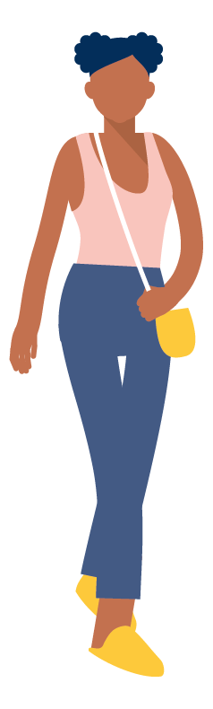
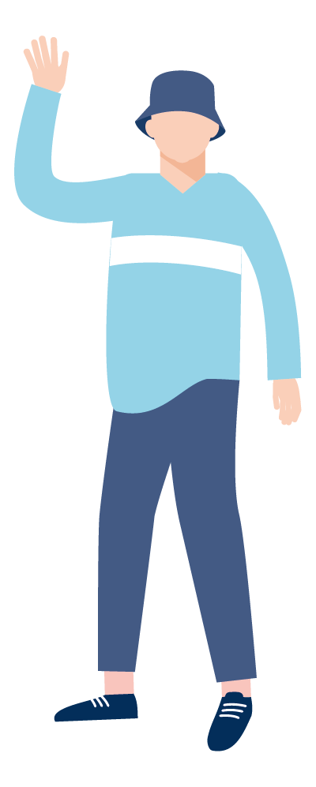


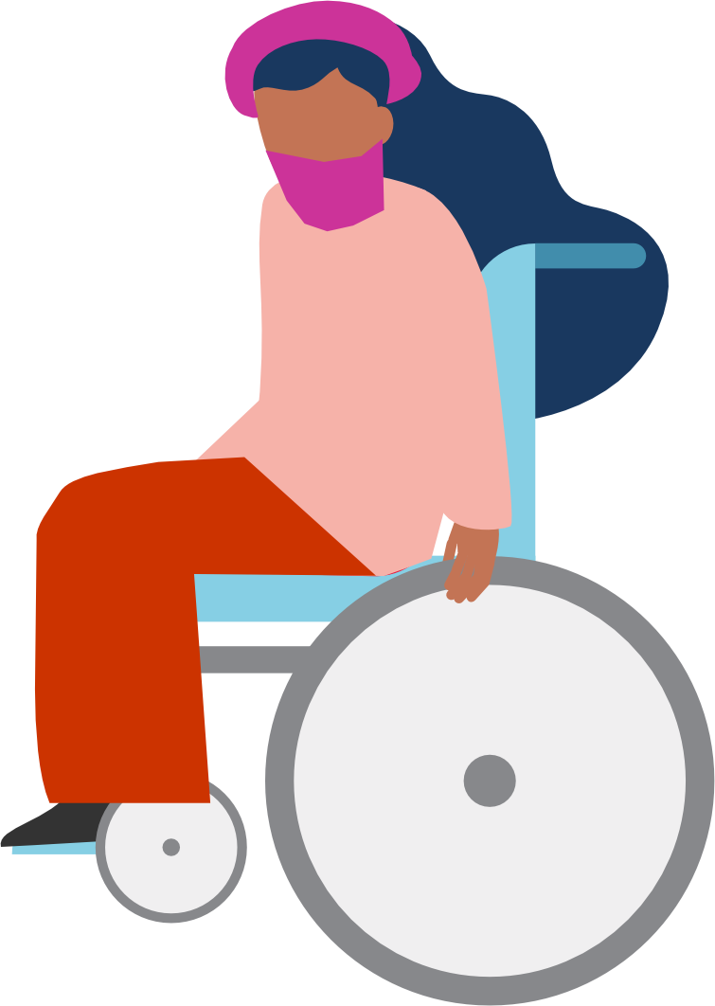
Step into walking

Slide 2
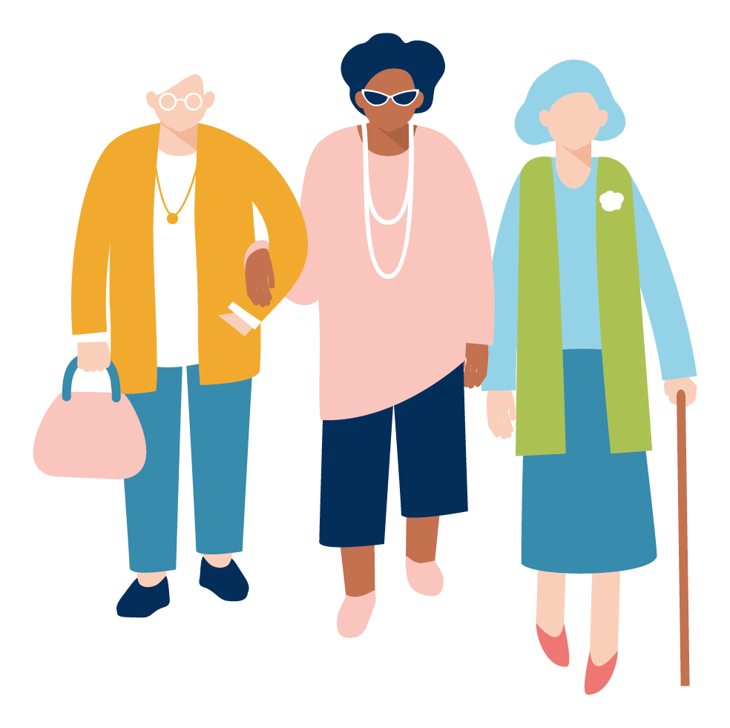
Step into walking
Walking can:
Connect you to your neighbours and your local community
Give you more energy
Help you to sleep better

Slide 3
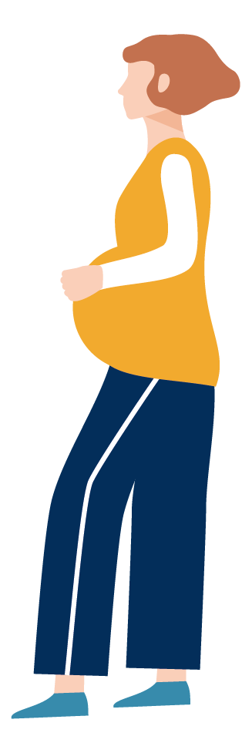
Step into walking
Walking can:
Be good for your mental health
Help you to manage your weight
Reduce your blood pressure

Slide 4
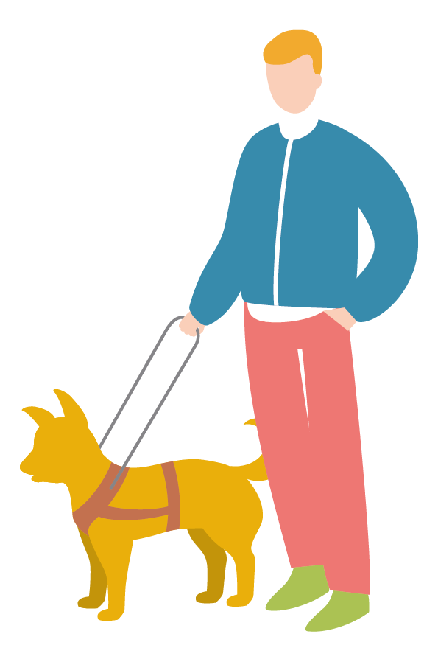
Step into walking
Walking can:
Make you feel good
Help you to meet new people and make friends
Learn things about your area – nature, history...

Slide 5


Step into walking
It doesn’t have to be about joining a walking group or going on a long hike.
It’s about moving more in a way that works for you.
Which could be to your front door or the shops or around the block.

Slide 6
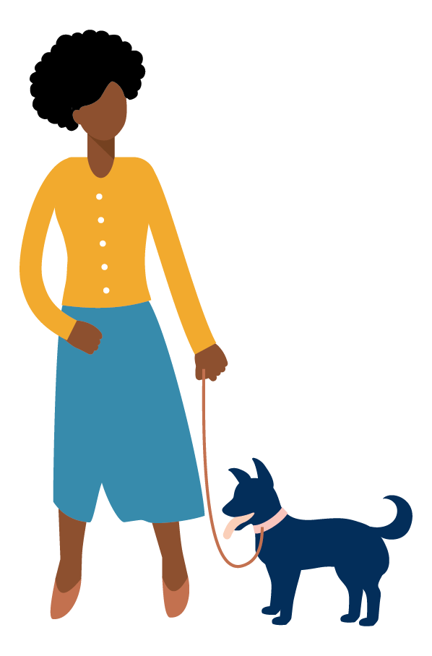
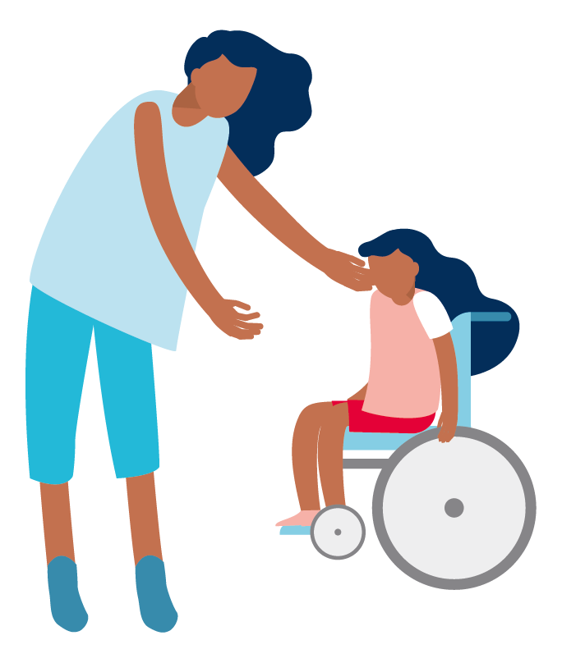
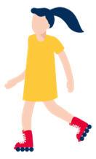
Step into walking
If you need support to take the first step, take a look at the
Walk Notts website
www.walknotts.org.uk

