Slide 1
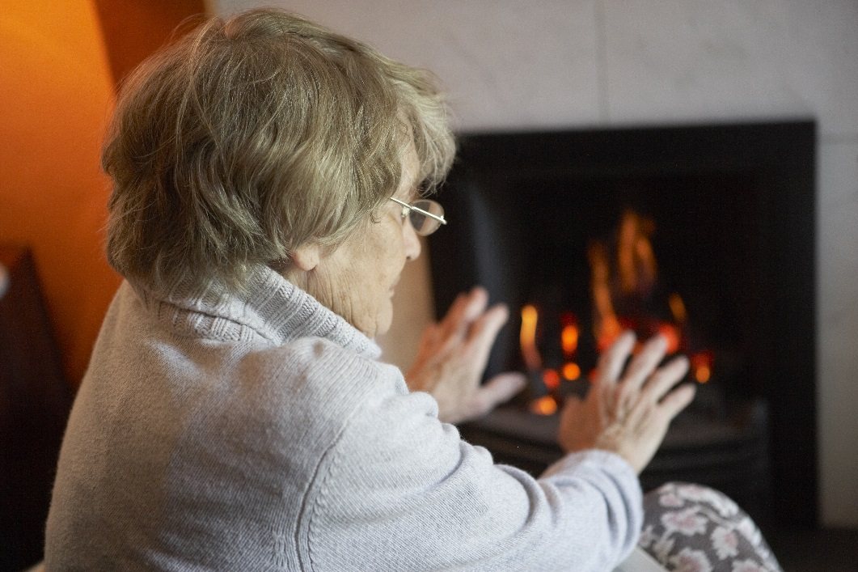
Warmer Derby & Derbyshire 3 Pete Burgess-Allen 25 January 2024
Together for Energy Efficient Homes
Notes:
Who we are - We are an independent charity supporting communities in the Midlands. We deliver practical solutions to reduce fuel poverty and cold homes, promote energy reduction and encourage the uptake of renewable energy. Our overriding objective is to support householders to stay warm and well at home.

Slide 2
Who are we?
We are an independent charity project supporting communities in Derbyshire, Shropshire, Telford & Wrekin. We deliver practical solutions to reduce fuel poverty and cold homes, promote energy reduction and encourage the uptake of renewable energy.
Our overriding objective is to support householders to stay warm and well at home.

Slide 3
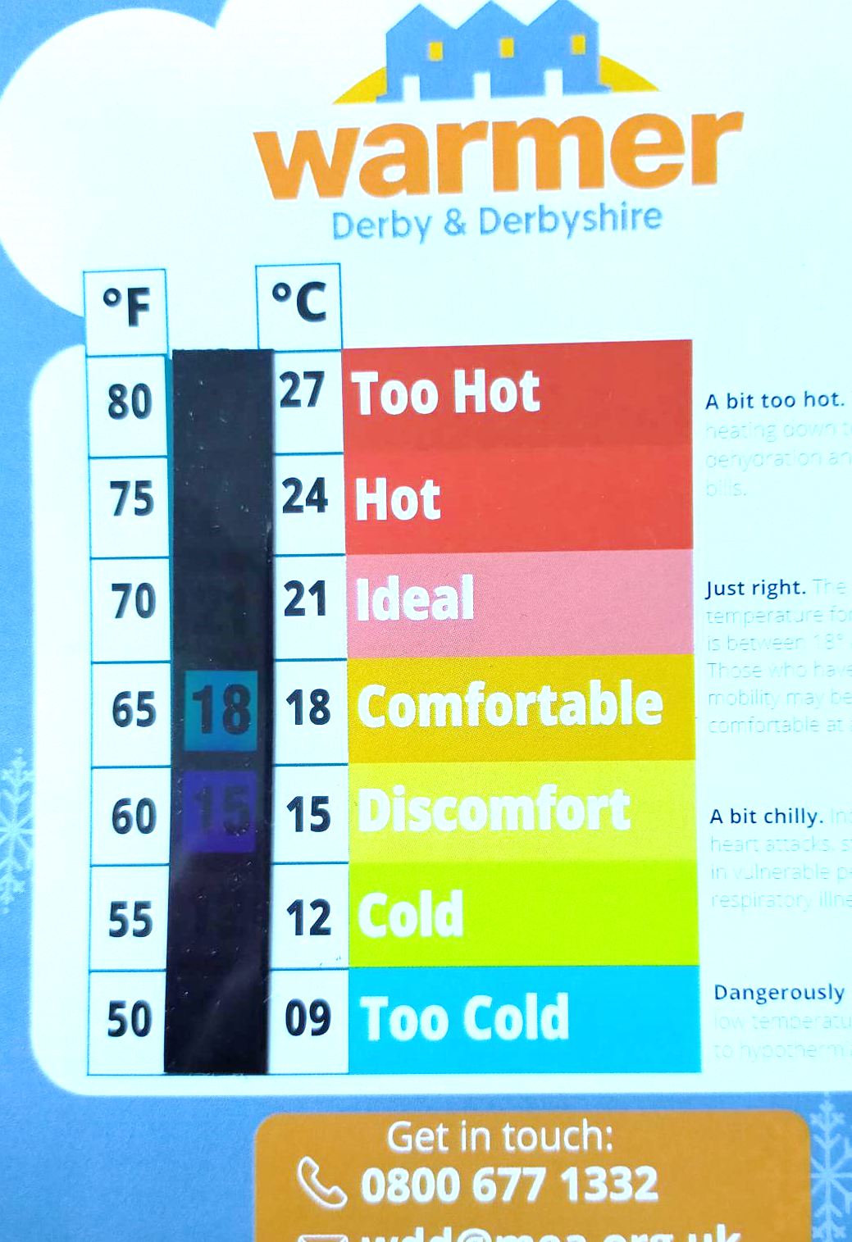
Health Impacts of Cold Homes
Heart attacks
Stroke
Pulmonary – asthma, COPD…
Mobility – arthritis, disability, falls…
Mental health – depression, anxiety…
Child attainment - worse school outcomes – long-term repercussions of lower incomes
prolonged recovery rates? Higher re-admission rates?
Housing Health & Safety Rating System – 29 Hazards – EXCESS COLD – highest HHSRS score…

Slide 4
From ‘The Real Cost of Poor Housing’ (2010) Roys, Davidson, Nicol, Ormandy, Ambrose

Slide 6
The HHSRS
comprises a risk assessment of 29 health and safety hazards which could lead to harm to the occupants
Any property that is assessed as having a Category 1 hazard on any of these matters can be classified as poor housing.
projected that in 2023, 14.4% (3.53 million) households will be in fuel poverty - up from 13.4% in 2022. (govt stats for ‘23 not in yet.)

Slide 7
Health Impacts of Cold Homes
Impact not just in extreme winter weather but also in moderate conditions ie outdoor temperature drops below 6°C.
being housebound increases both the exposure to an underheated home and the cost of heating it.
https://www.nice.org.uk/about/nice-communities/social-care/quick-guides/helping-to-prevent-winter-deaths-and-illnesses-associated-with-cold-homes

Slide 8
Causes of high bills & Fuel Poverty
Causes of either high fuel bills or rationing of fuel use include:
1 High Energy Costs : (paying an expensive fuel tariff, dependent on elec’, oil, LPG)
2 Poor energy efficiency of the home
3 Not using energy efficiently in the home
4 Low income

Slide 9
Price Cap Changes January 2024 – Home energy advice
The price cap is calculated using the average household use of energy
Average Dual Fuel 12000 kWh gas, 2900 kWh electric​. Average all electric 4200 kWh​
Up from £1834 to £1928 - Direct Debit
Down from £1926 to £1917 – Prepayment
Up from £2052 to £2058 – Other/Cheque (+7%)
The price cap is not the maximum you will pay per year​. If you use more units, you will pay more. Use less, you will pay less.
Cut unfair direct debits - MoneySavingExpert

Slide 10
Price Cap Changes January 2024– Home energy advice
What are the average unit rates?
Electricity
Single Rate 28.62 p/kWh
Standing Charge 53.35p/Day - £16.23/Month
Economy 7* 35.53p/kWh Day 15.78p/kWh Night
Gas
Rate 7.42p/kWh
Standing Charge 29.60p/Day - £9.00/month
Annual S/Charge £302.76 = £25.23/month
Notes:
*Economy 7 rates vary significantly by area. Those used are from Octopus for the West Midlands area, which includes most of Shropshire

Slide 11
AVERAGE SPEND FOR HOUSEHOLDS FROM 1st July 2023
What’s the average household spend for gas (including standing charge)?
Gas usage | Average annual consumption | Average annual cost | Average monthly cost
Low (flat or 1-bedroom house / 1-2 people) | 8000 KWh | £927.99 | £77.33
Medium (3-bedroom house / 2-3 people) | 12000 KWh | £1339.99 | £111.67
High (5-bedroom house / 4-5 people) | 17000 KWh | £1854.99 | £154.58
What’s the average household spend for electricity (including standing charge)?
Electricity usage | Average annual consumption | Average annual cost | Average monthly cost
Low (flat or 1-bedroom house / 1-2 people) | 1800 KWh | £781.24 | £65.10
Medium (3-bedroom house / 2-3 people) | 2900 KWh | £1155.21 | £96.27
High (5-bedroom house / 4-5 people) | 4300 KWh | £1631.21 | £135.93

Slide 12
Warmer Derby & Derbyshire 3
£603,000 ‘Energy Redress’ grant
2 years from 1st Feb ’23
Freephone/Referral :
Billing issues
Efficiency advice
Practical – home visits
Low-cost measures
Crisis support
Access to grants

Slide 13
Warmer Derby & Derbyshire 3
Drop-in surgeries
Staff briefing sessions
Events

Slide 14
What is a hard-to-heat home?
Any house can be hard to heat if the cost of heating it
to a comfortable and safe temperature is more than the
resident can afford. However, houses with the following
• broken or draughty windows and doors
• reliance on more traditional heating methods (for
example, storage heaters)
• lack of loft space and homes that are part of
high-rise blocks.

Slide 15
Home improvements - funding
ECO-4 :
eg, insulation or upgrade of inefficient heating system
owner occupiers :EPC band D-G
private rented: EPC band E-G.
Benefits or income < £31000
electrically heated properties particularly insulation and dual measures involving substantial insulation works.
Connected for Warmth scheme https://www.connectedforwarmth.org.uk
homeowners and privately rented (subject to funding.) epc EFG
loft and cavity wall insulation: 0800 107 8576 .
​Air source Heat Pumps : 0800 029 4547 currently reliant on electrical heating system.
Low income or Health condition
Smart Heating controls
Smaller energy saving measures
​
info@connectedforwarmth.org.uk

Slide 16
Great British Insulation Scheme
https://www.gov.uk/apply-great-british-insulation-scheme
0800 098 7950
Or apply through your energy supplier
Who is eligible?
Those living in homes with an Energy Performance Certificate (EPC) rating D-G and within council tax bands A-D
Householders receiving qualifying benefits and living in homes with an EPC rating of D or below.

Slide 17
Great British Insulation Scheme
Cavity wall insulation (including party walls)
Solid wall insulation (both external and internal)
Loft insulation
Pitched roof insulation
Flat roof insulation
Under floor insulation
Solid floor insulation
Park home insulation
Room-in-roof insulation
Owner-occupied households in the low-income group will be able to receive heating controls as well

Slide 18
HEAT-Hub project – MEA & NEP
Target : Home-owners – looking for help to improve energy efficiency
Hard-to-treat properties (EPC E-G)
off-gas heating systems (eg storage heaters, oil, LPG)
In conservation areas
Provide advice and home energy surveys with links to installers.
https://www.homeenergyadviceteamhub.uk/

Slide 19
Priority Services Register – extra help when there is an unplanned cut in electricity or water supply
have reached your state pension age
are disabled or have a long-term medical condition
are recovering from an injury
have a hearing or sight condition
have a mental health condition
are pregnant or have young children
have extra communication needs (such as if you don’t speak or read English well)
need to use medical equipment that requires a power supply
have poor or no sense of smell
would struggle to answer the door or get help in an emergency.
You might still be able to register for other reasons if your situation isn’t listed. For example, if you need short-term support after a stay in hospital.

Slide 20
PSR
Advanced notice of planned interruptions to your electricity or water supply.
Advice on how to be prepared for a power cut or water outage and what to do if one happens.
A cold weather crisis pack (where available).
A direct number to get straight through to the network operator in the event of an unplanned power cut.
Special help if you need it from emergency response organisations e.g. free bottled water or a generator for medical equipment.
bills can be sent in a different format eg Braille or another language.
option of a password if the supplier needs to visit you.

Slide 21
Smart meters
Avoids the need to access meters in difficult spaces.
Keep bills accurate
Where Smart meters aren’t workable, they may move traditional Prepayment meters to more convenient locations if on PSR.
OR provide a meter reader to attend the property.

Slide 22
Priority Services register – PSR Distribution companies
Free Extra help for more ‘vulnerable’ customers :
electricity distributors
https://www.nationalgrid.co.uk/customers-and-community/priority-services/benefits-of-being-on-our-register
extra support during a power cut. Elderly, very ill or disabled people, or those who rely on power for medical equipment.
Gas distributors
https://cadentgas.com/help-advice/supporting-our-customers/priority-services-register
Incl Providing translation services should there be a need for it 24/7, 365 days of the year.

Slide 23
TIPS to consider
turn down the hot water flow to 55ºC degrees, and the radiators to 50ºC on a condensing gas boiler. This can save 7-9% on running costs
Reduce showering time in electric showers. By reducing a daily shower from 10 to 5 minutes could save £100 per year per person. That’s £400 for a family of four. It also reduces water consumption, important if on a water meter
Insulate, insulate, insulate. Always worth checking for grants relating to insulation of the home.
The ECO4 scheme provides grants to fund energy-efficient upgrades to homes reducing emissions, electricity and energy bills (household income under £31k; owner occupiers :EPC band D-G & private rented: EPC band E-G. )
Connected for Warmth: This loft and cavity wall insulation offer is available to homeowners and privately rented properties, (subject to availability of funding). Council Tax Bands A, B, C or D

Slide 24
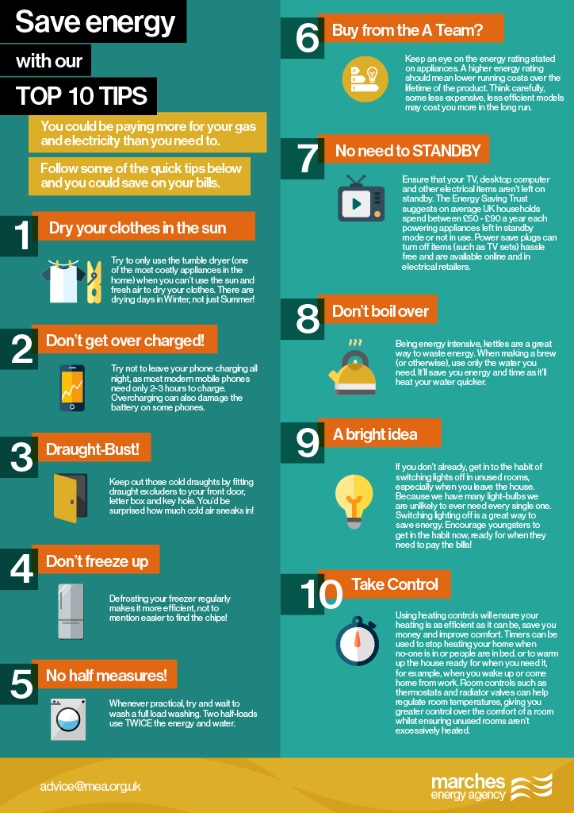

Slide 25
20 BEHAVIOUR CHANGES TO REDUCE ENERGY BILLS

Slide 26
Heat the human, NOT THE HOME
 | Heat method | Initial cost | Cost / hour | Cost/ week
USB Gloves | Plug into USB | £5 | Less than 1p | 4p
Heated Insoles | Plug into USB | £8 | Less than 1p | 4p
Electric gilet | Charge via USB | £46 inc battery | Less than 1p | 4p
HW Bottle | kettle | £5.50 | 6p | 78p
Microwaveable wheat bag | m/wave 60secs | £4 | 1p | 49p
Reuseable hand-warmer | Boil water on hob | £5 | Gas hob 2p Elec 7p | 98p £3.43
Elec blanket | Mains | £14 | 3p | £1.37
Elec footwarmer | Mains | £25 | 2p | £1.05
Elec heat pad | Mains | £15 | 2p | £1.05

Slide 27
Referrals and freephone
wdd@mea.org.uk
0800 677 1332
@WarmDerbyDerbyshire
@WarmerDandD
Any questions? Don’t hesitate to contact me on peter@mea.org.uk
Or Claire Woolley claire@mea.org.uk

