Slide 1
ABOUT US
The Locality Team brings together a core team of council officers who are focused working together with citizens, their friends, family’s and communities to build on and build up our vision:
Every person in Derby should be able to live in a place they call home, with the people and things that they love, doing the things that matter to them; as part of a community where they look out for one another.

Slide 2
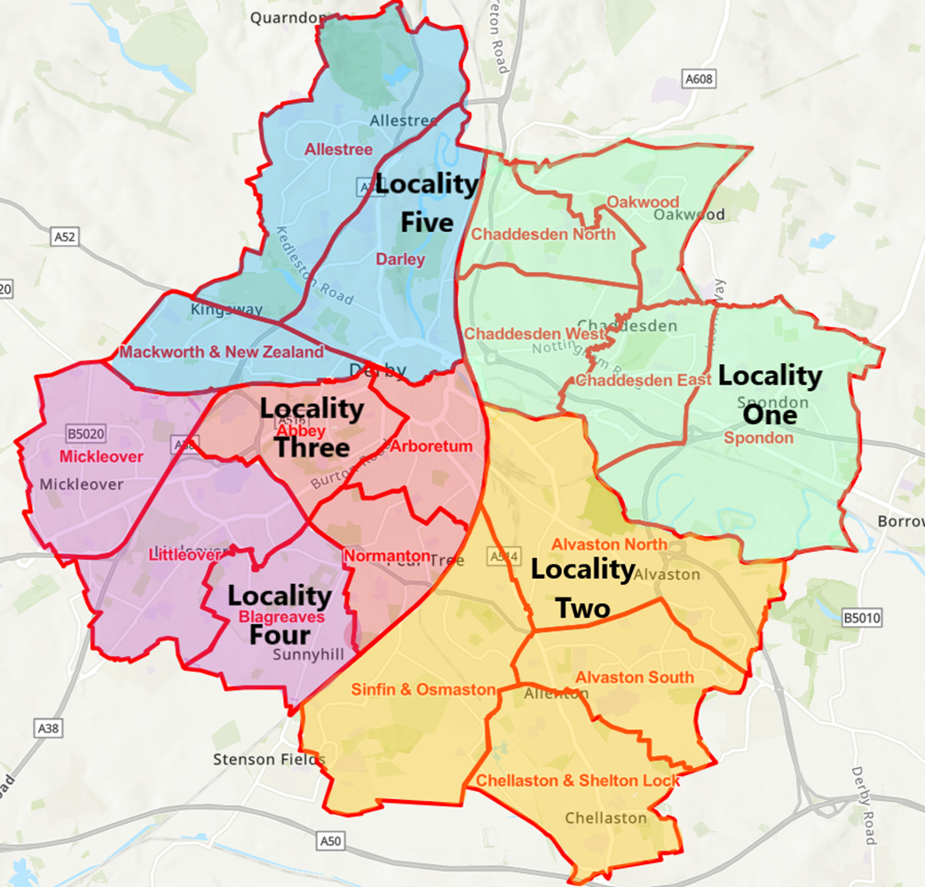

Slide 3
Core team members
Locality Manager
Locality Officer
Responsible for the day-to-day operations of a locality team
Connect & collaborate with a range of partners around complex place-based issues
Strategic overview of locality plans
A focus on coordination & delivery of locality plans – enabling joined up action.
To support elected members in their community leadership role.
Public Protection Officer
Local Area Coordinator
Reduce incidence of environmental crime – littering, fly tipping, dog fouling, ASB
Using appropriate enforcement approach to tackling community issues.
Work with partners to support community safety & neighbourhood
Focus on working with individuals in communities to prevent, reduce or delay the need for formal and expensive services.
Help people make the most of personal resources & local networks
3

Slide 4
Locality Plans - Proposal
Integrate existing data - Engagement, neighbourhood audits, partners plans, intelligence, data
Produce a draft Locality Plan that identify key themes.
Co-design working document with all relevant parties. Identifying each areas priorities
Learning, reflection, re-design - identity new priorities modify the plan
Embedding and influencing

Slide 5
Based on total number of residents ages 0-19 living in households of relative or absolute poverty
 | Absolute Poverty (Count) | Relative Poverty (Count) | Absolute Poverty (%) | Relative Poverty (%) | All Povert (Count) | All Poverty (%)
Blagreaves | 1047 | 1180 | 28.70 | 32.35 | 2227 | 61.06
Littleover | 504 | 573 | 13.03 | 14.81 | 1077 | 27.85
Mickleover | 318 | 336 | 10.81 | 11.42 | 654 | 22.24

Slide 6
LSOA’s with highest rates of Disability (under the Equality Act) | Percentage per LSOA
Blagreaves cp. King George V Playing Flds. | 20.9%
Blagreaves cp. Donnington Drv Sunny Hill area | 20.8%
Blagreaves cp. Oaklands Ave off Stenson Rd | 20.3%
Littleover cp. Junc. Wilson Ave. & Field Rise | 17%
Littleover cp. Kingsway Hospital | 17.8%
Mickleover cp. Junc. East Ave. & Devonshire Drv. | 20.4%
Mickleover cp. Junc. Wade Drv. & Cavendish Way | 20.8%
Mickleover cp. Junc. Vicarage Rd & The Hollow | 26.4%
Notes:
Derby Av. 18.7%

Slide 7
Population Average Ages 55-85+
Locality: 34.5%
Derby: 27.6%
Key Population Percentage

Slide 8
Support Social Opportunities
Partnership Networks
Community hubs
Communication & participation
Support Health & Social Care Services
Information opportunities & support
Support & develop key groups
Hospital- Home- Community integration pathway
Empower Community Voice
Opportunities & platform to share views & concerns
Collaboration
Relevant services
Locality Priorities

Slide 9
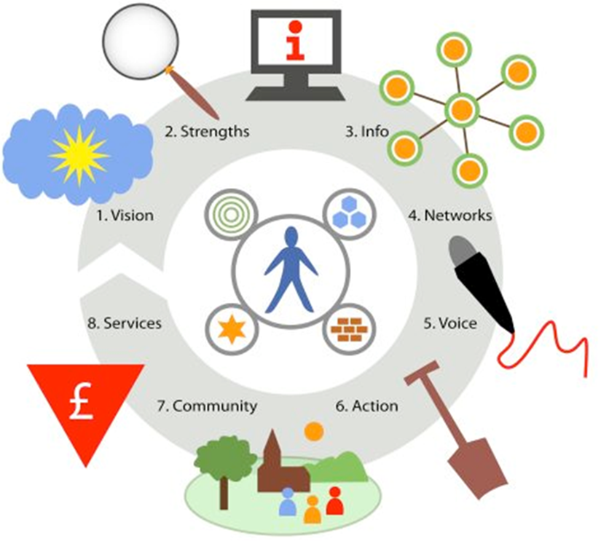
Local Area Coordination
Notes:
“what services and money do you need and how can I find them for you?”
“what would a good life look like for you and how can we get there?”
1. think about your vision for a good life - Time to talk and think about what would make life better
2. identify your strengths, skills and gifts - Help finding opportunities to use your gifts and strengths to build your version of a good life
3. access a range of information - Support to find information or help navigating everything (services, internet, life!)
4. develop relationships and community networks - Support to meet new people or connect
5. get your voice heard - Help to speak to services and professionals and where to find them
6. take actions to make your life better - Help with planning practical steps to make changes
7. be more involved in your community - Information about activities and groups in the area
8. LAC knowledge – Sharing knowledge with services to help them understand community need and their cultural approach, sharing knowledge with individuals and communities about what services are available

Slide 10
Increase in valued, informal, support relationships – reducing isolation
Increasing capacity of families to continue in caring role
Improved access to information
Better resourced communities
Improved access to specialist services
Support into volunteering, training and employment
Preventing crises through early intervention
Changing the balance of care to the use of more informal supports and diverting people from formal services

Slide 11
The role of the Hospital LAC
Ensuring the correct processes are in place that facilitate discharge
Introducing residents to services and helping them access support
Improving outcomes for residents
Offering ‘short term’ support- hospital LAC can ‘react’ quickly to help resolve a situation
Examples include facilitating discharge through liaising with professionals, supporting services to make housing suitable for residents returning home, connecting residents to relevant service providers and professionals

Slide 12
Themes- Reoccurring issues that prevent Discharge
Housing Conditions
Hoarding
Care Packages
Finding suitable short-term care
Health and Wellbeing
Health conditions and mental health
Environmental hazards/fire safety
Home adaptations
Finding a care home
Communication between professionals
Packages of care
Safeguarding
Cost
Isolation
Confidence
Lack of support network

Slide 13
Alan was discharged after a 2 week stay in hospital and was provided with a profiling bed but found this very uncomfortable. Alan was sleeping downstairs after discharge as he struggled to get upstairs. Hospital LAC connected Alan to Disability Direct to support with food shopping/medication, as well as a LAC in the community.
Alan was supported by LAC to make a referral to Carelink alongside having discussions with Healthy Housing to improve the entrance and exit of property with steps and handles, as well as fitting fire and carbon monoxide alarms and carrying out pest control.
A referral has been made to Occupational Therapy for Alan’s bed. Alan’s care calls are due to be stopped as he is gaining strength, he can go up and down the stairs again as well as being able to prepare his food independently.
LAC supported Alan to see if he qualifies for Attendance Allowance alongside being supported to discuss POA with a solicitor. Carelink has now been fitted and Shared Agreement completed. Also supported with contacting the GP regarding medication. Alan stated he was feeling positive about the support he is receiving.
Contractors from Healthy Housing have completed the work and modifications in Alan’s home, as well as fixing the leaking roof and shower.
Alan has not had any further hospital admissions and has not required any further support from Adult Social Care. Alan is able to be independent again and continues to be supported by LAC.
Links made to Services: Disability Direct
Carelink
Healthy Housing GP Occupational Therapy
- No further hospital admissions
- Reduction in care package
Case Study Alan is in his 90’s and was admitted to hospital after having a fall in his home.
1-2 weeks after discharge
1 month after discharge
2-3 month after discharge

Slide 14
What we’re currently doing/Exploring
Priorities
Local Area Coordination
Hospital Discharge packs
Pop-up events
Falls steering group
Falls Ambassadors/champions

