Slide 1
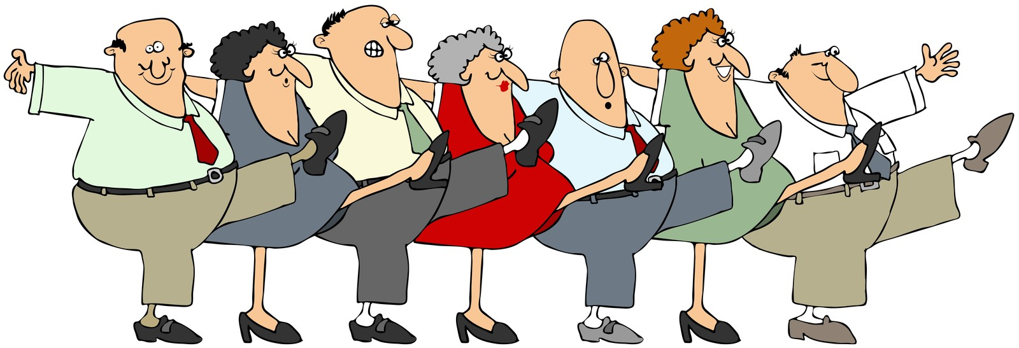
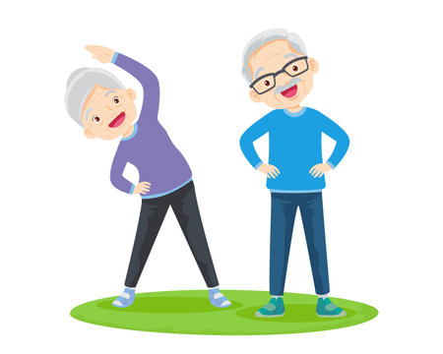
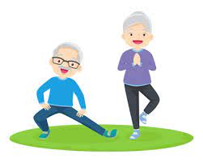
Rivendell View Care Home
How we help to keep the residents active.

Slide 2
The Importance of exercise
Exercise is one of the most important ways to maintain independence and ensure we stay
steady on our feet and have good balance, which will help the reduce the risk of falling.
Looking at activities that improve muscle strength in our arms, legs, back, shoulders and chest are important as we get older.
Simple exercise and movement will help make it easier to get up out of a chair, improve posture, co-ordination and balance, which in turn will reduce falls and the fear of falling.

Slide 3
How can TikTok help?
Quality time spent with the residents
Having fun
Activity without even knowing it
Something to look back on

Slide 6
Difficulties encountered with TikTok
Understanding of what TikTok is and why we are doing them
Involving all of the residents
Not being able to post the residents without capacity
Thinking up ideas that are suitable

Slide 7
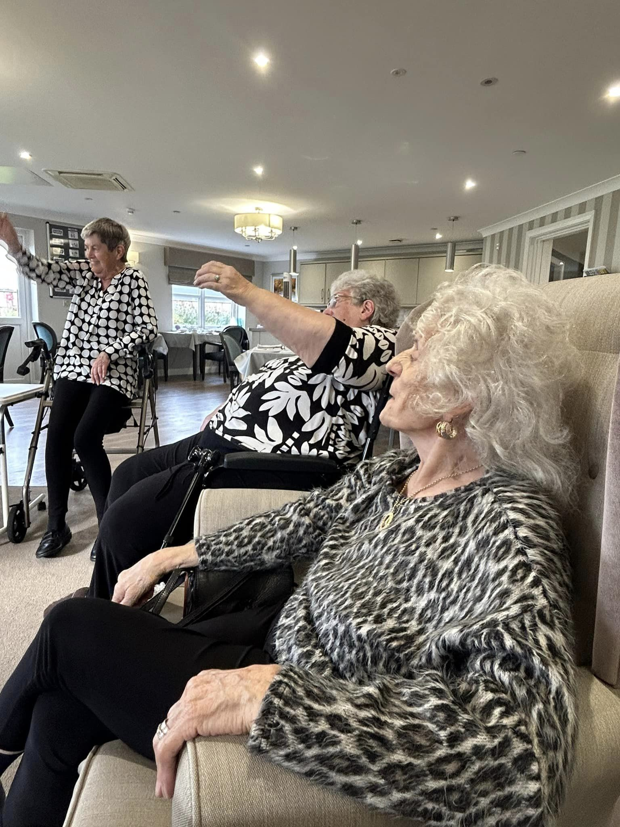
Weekly Armchair Exercises
We have managed to find a trainer that comes to the home every week to do armchair exercises
Ross comes every Thursday and we alternate onto different floors of the home
Good for any ability
Those not actively taking part still watch the others and do little bits

Slide 8
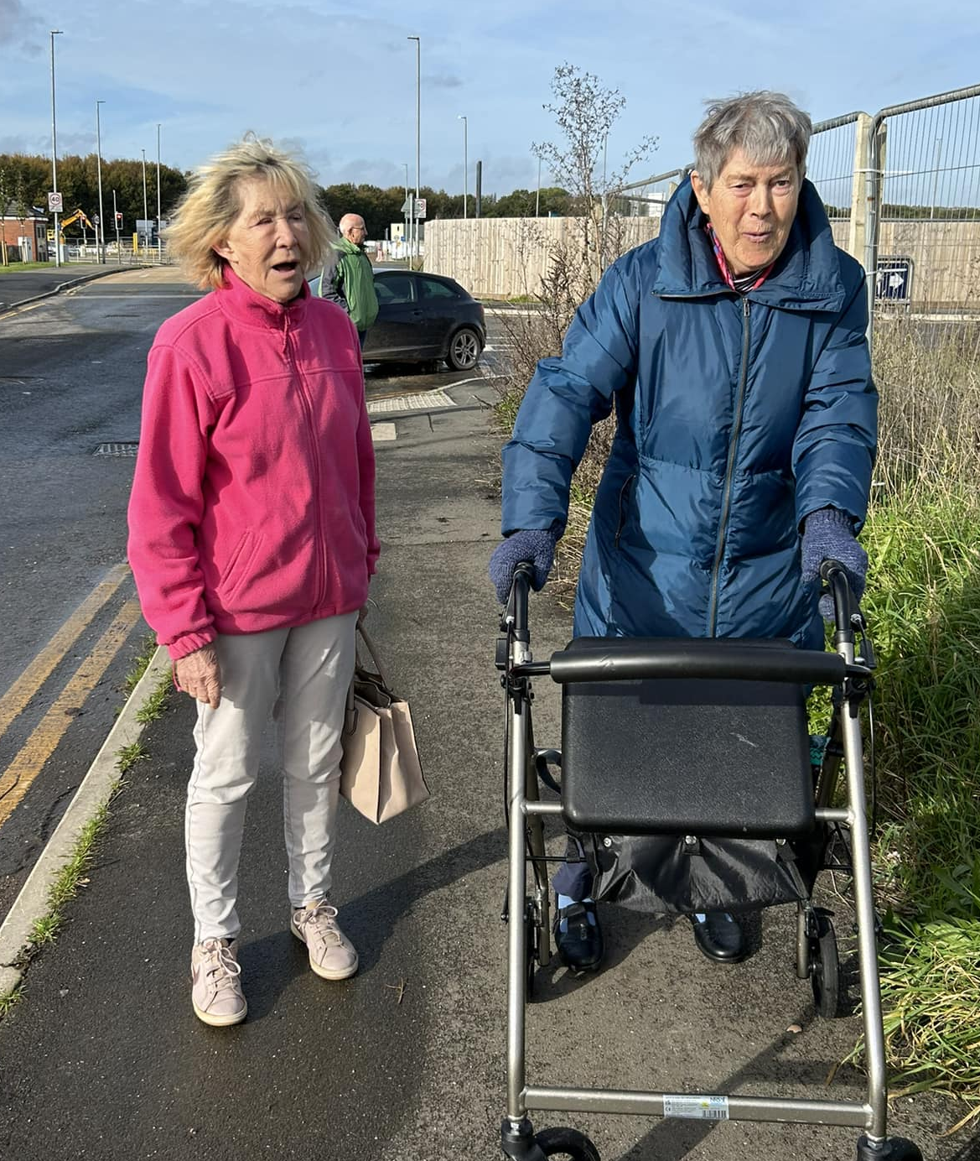
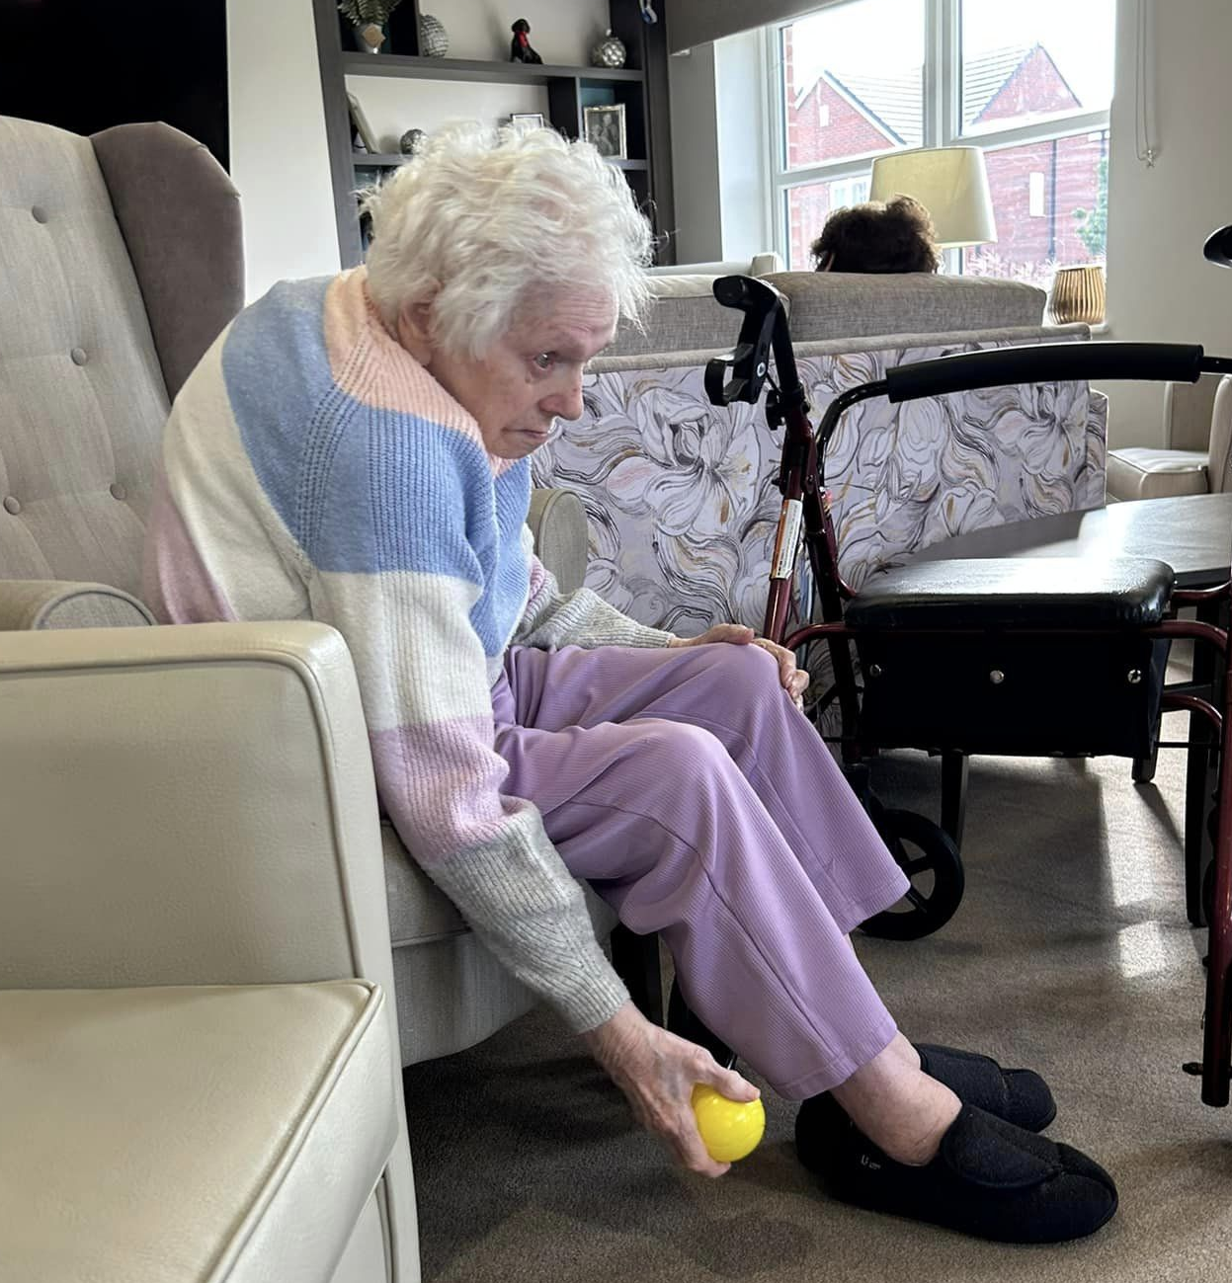
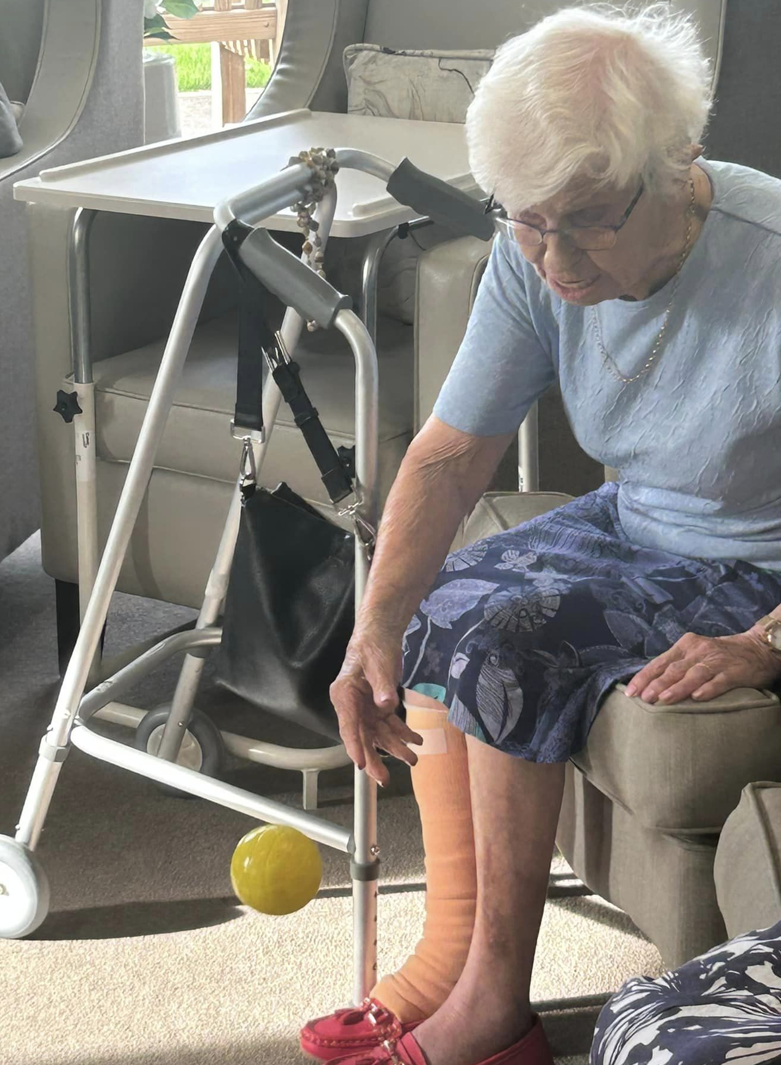
Other activities in the home
Gentle walks to the local shops
Carpet bowls

Slide 9
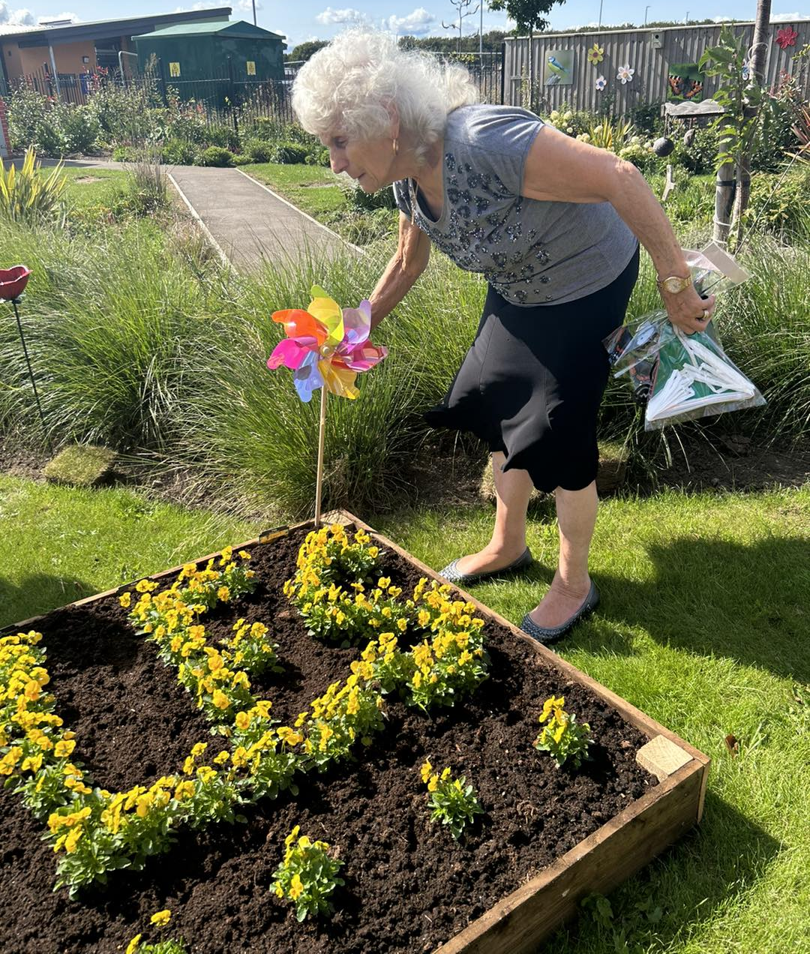
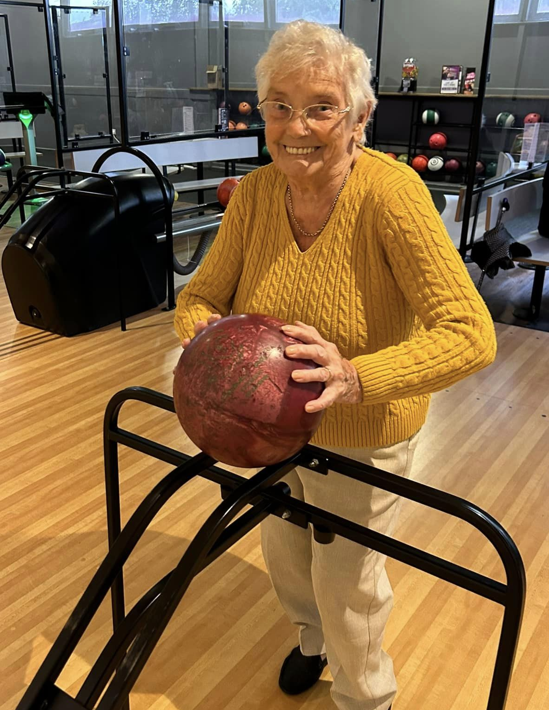
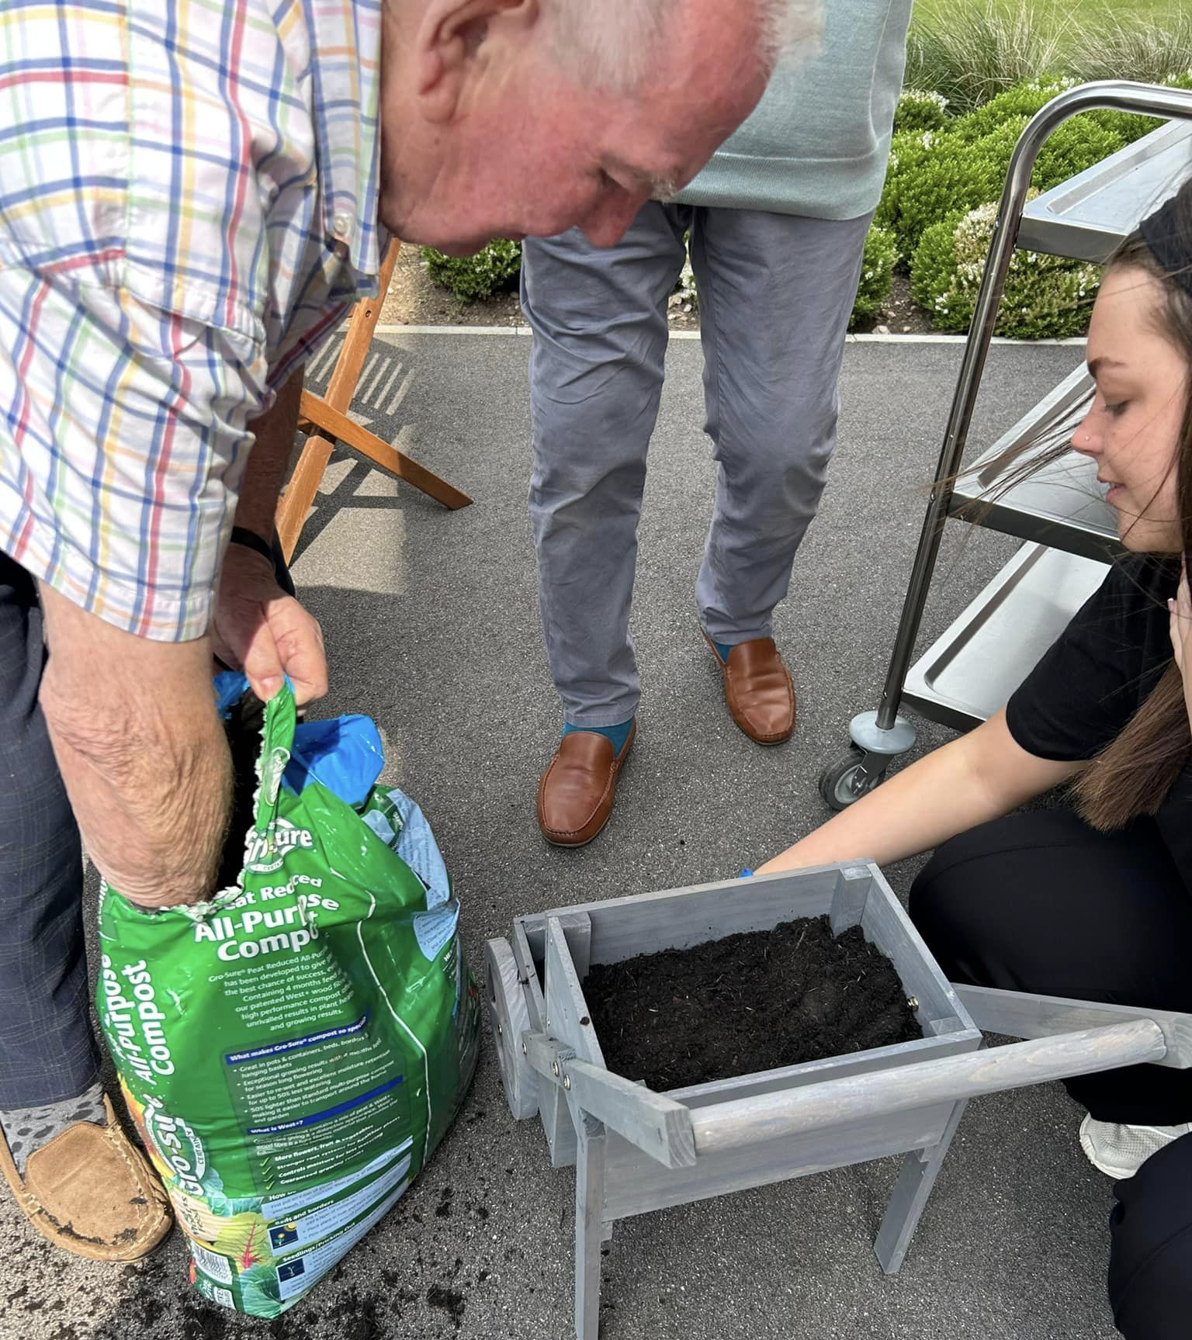
Ten pin bowling
Spot of gardening

Slide 10
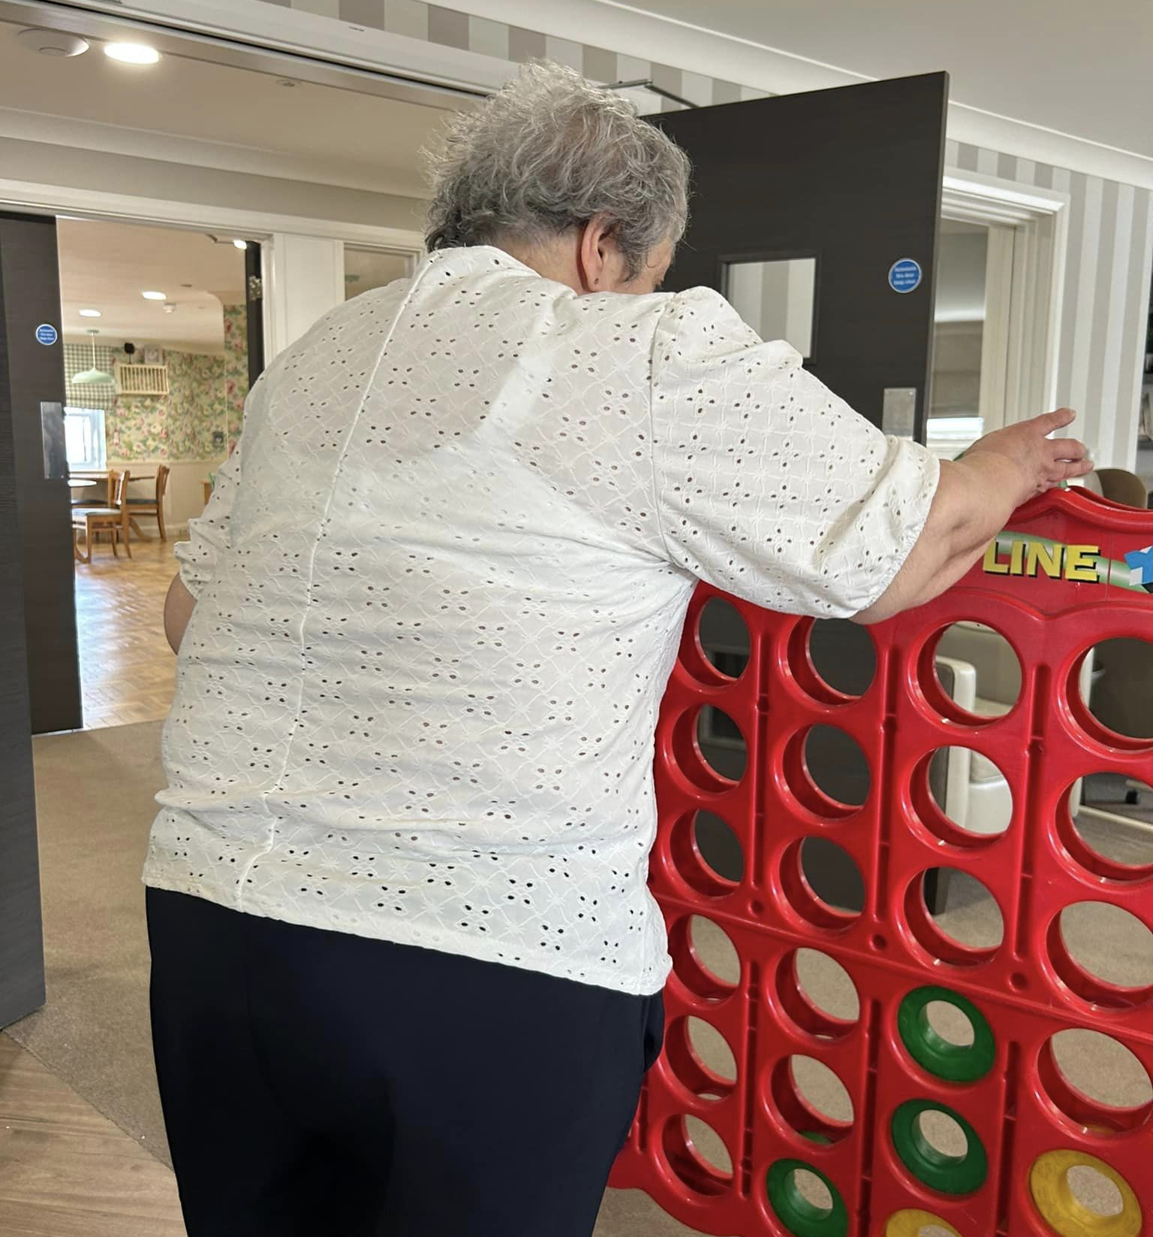
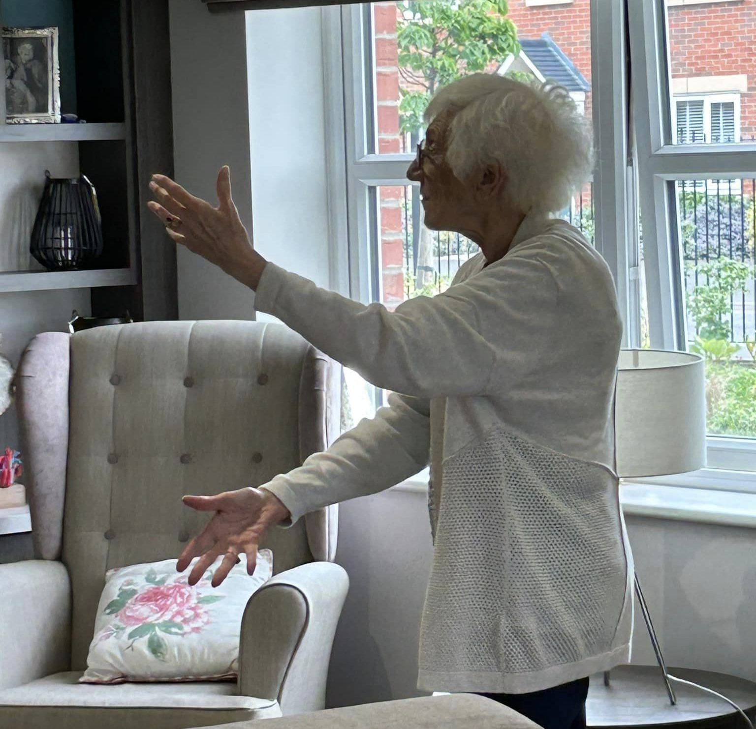
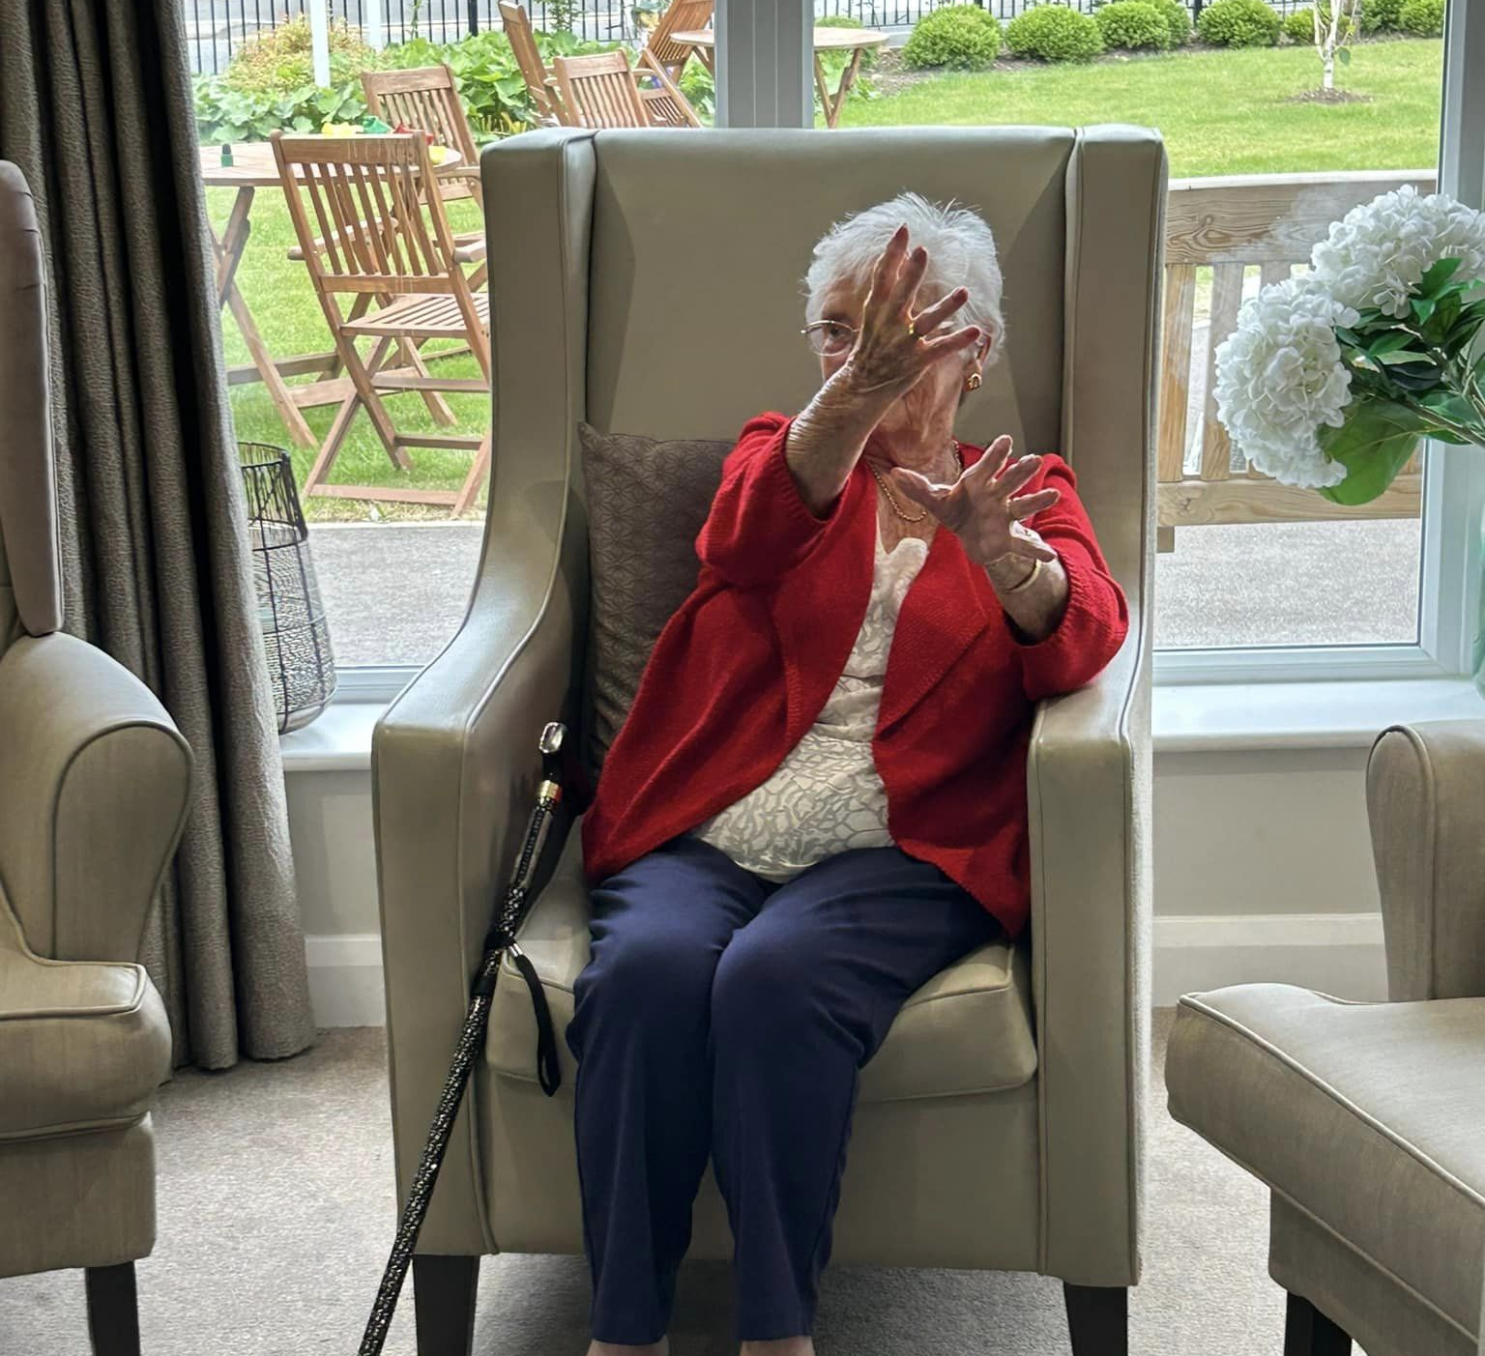
Connect Four
Tai Chi

Slide 11
THANK YOU!

