Slide 1

Just Good Friends
Talking Space Presentation

Slide 2

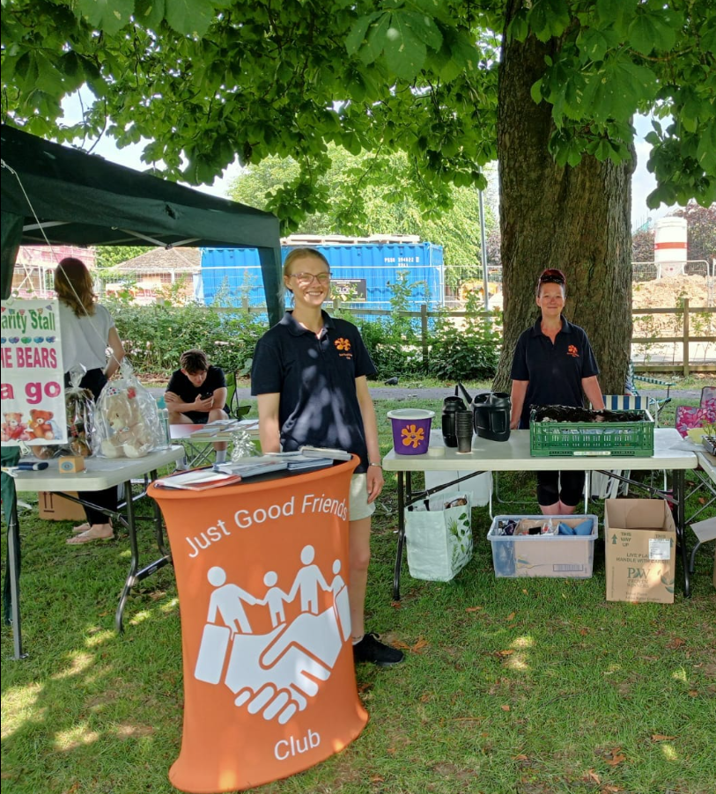
Who are we?
Just Good Friends Club is a registered non-profit charity that offers support and services to adults with learning disabilities in Derbyshire.
The charity formed in 1996 after an advocacy group of adults with learning difficulties formed an evening group for the purpose of socialising, currently JGFC has 6 evening groups.
We opened our first Social Hub in 2021 in Clowne when Derbyshire County Council closed 8-day centers in the Northeast of the county, we currently have 4 Social Hubs supporting 82 members.
In our Social Hubs we support our members practice transferable skills such as travel training, shopping and budgeting and cooking a meal for themselves. We encourage our members to participate in activities and hobbies, such as chair-based exercises, sports and games and gardening. We organise day trips and weekends away, we also have a nightclub event in Chesterfield once a month, an event that is open to all adults with learning disabilities and their carers whether they are our members or not.

Slide 3
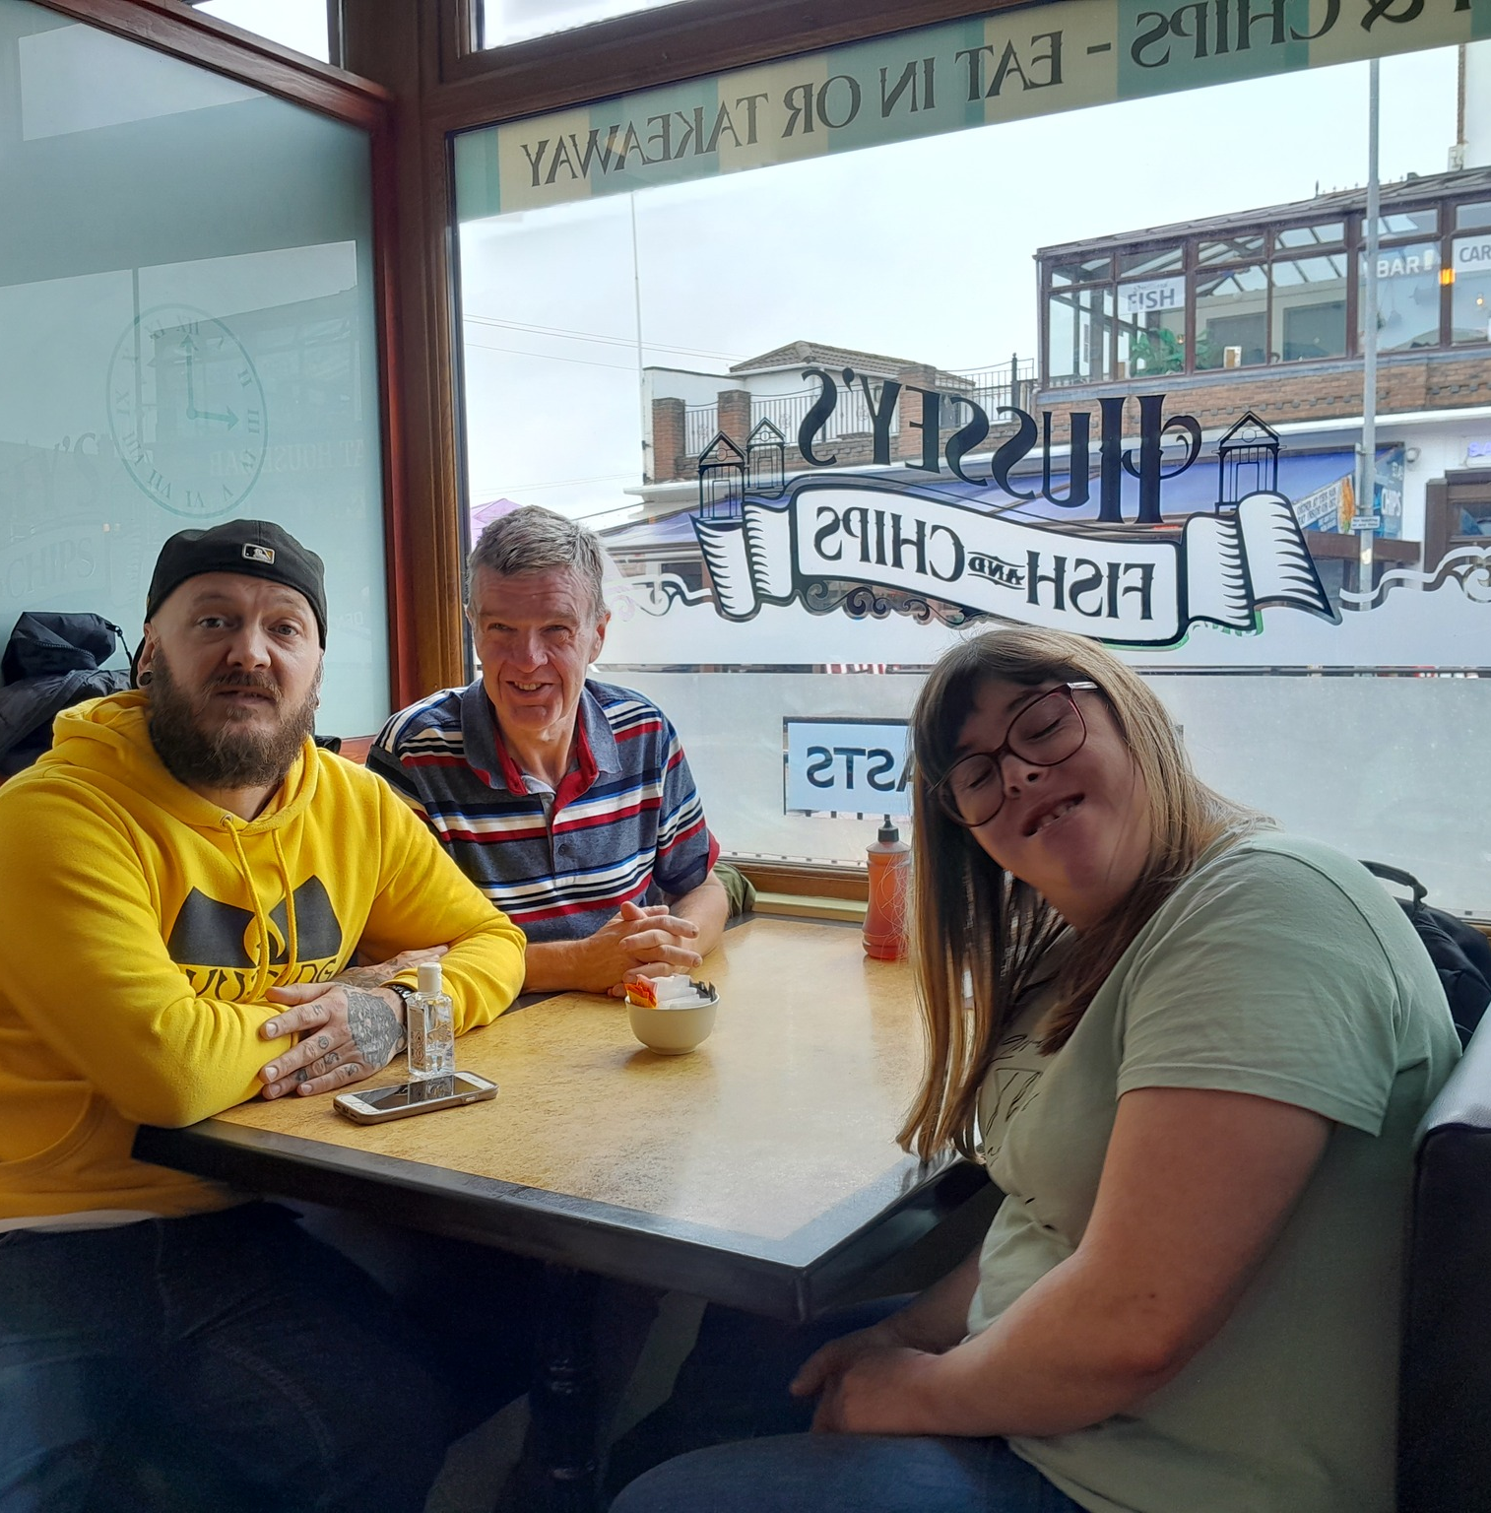
Our Project
We wanted to encourage our members to be more active, take more interest in their health and wellbeing and what they ate.
This got off to a slow start......

Slide 4
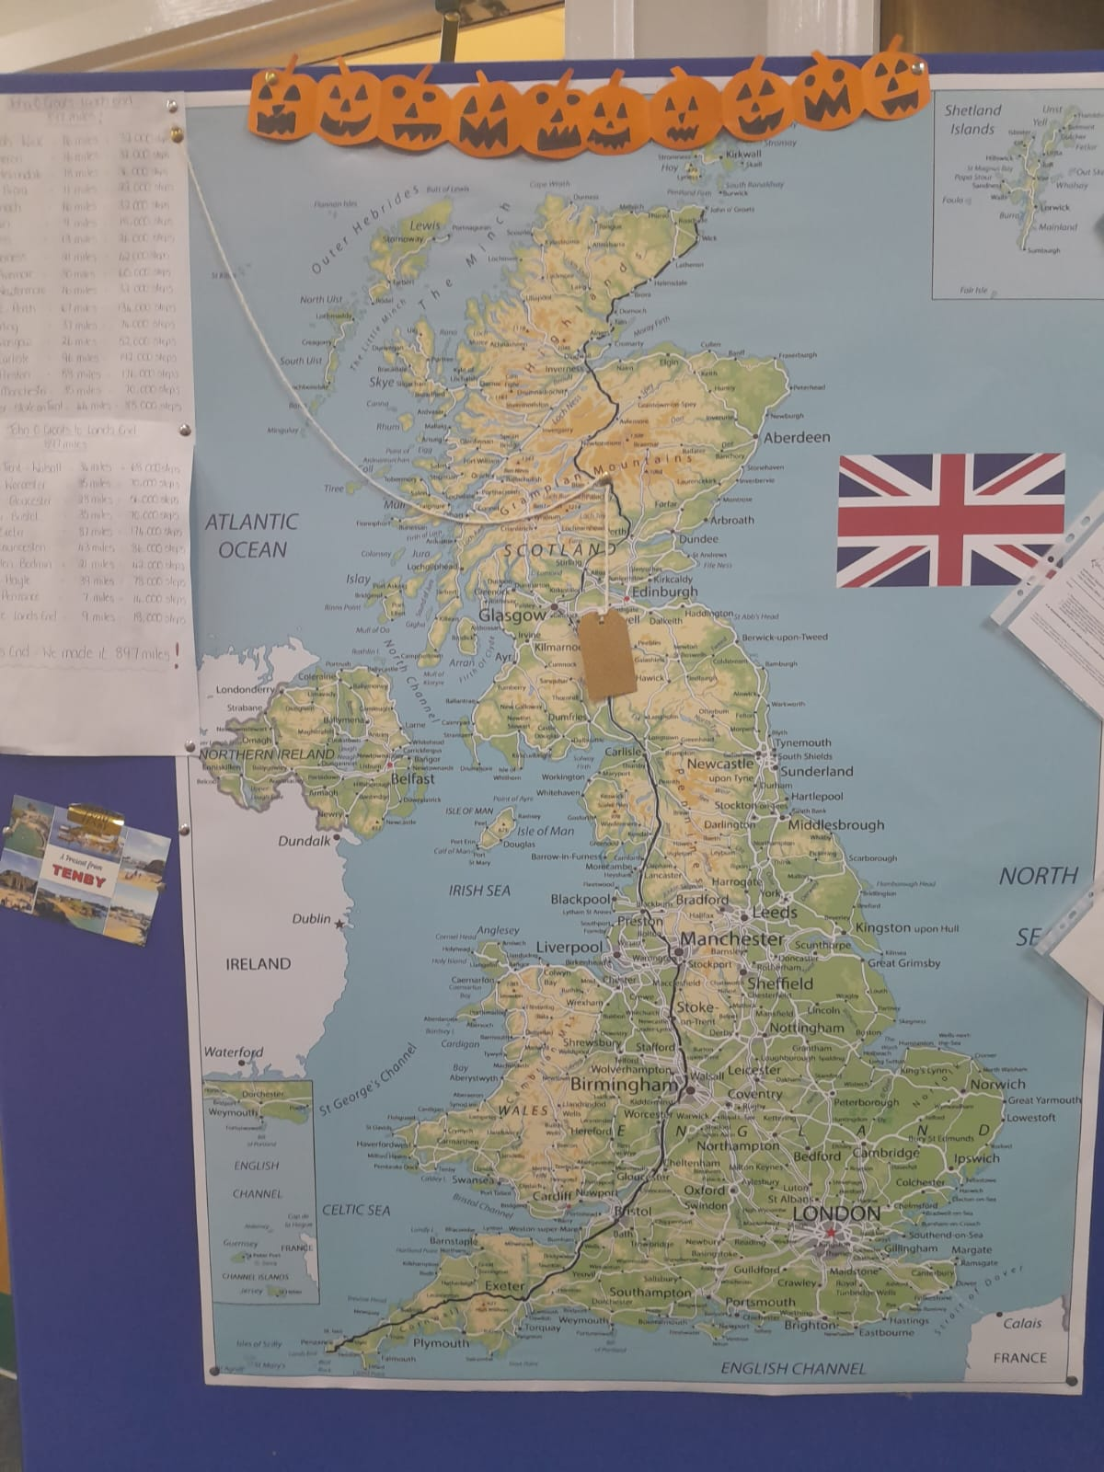
The race is on
Land's End – John O'Groats
(or John O'Groats to Land's End at our Coal Aston Hub).
But that's not the end....

Slide 5
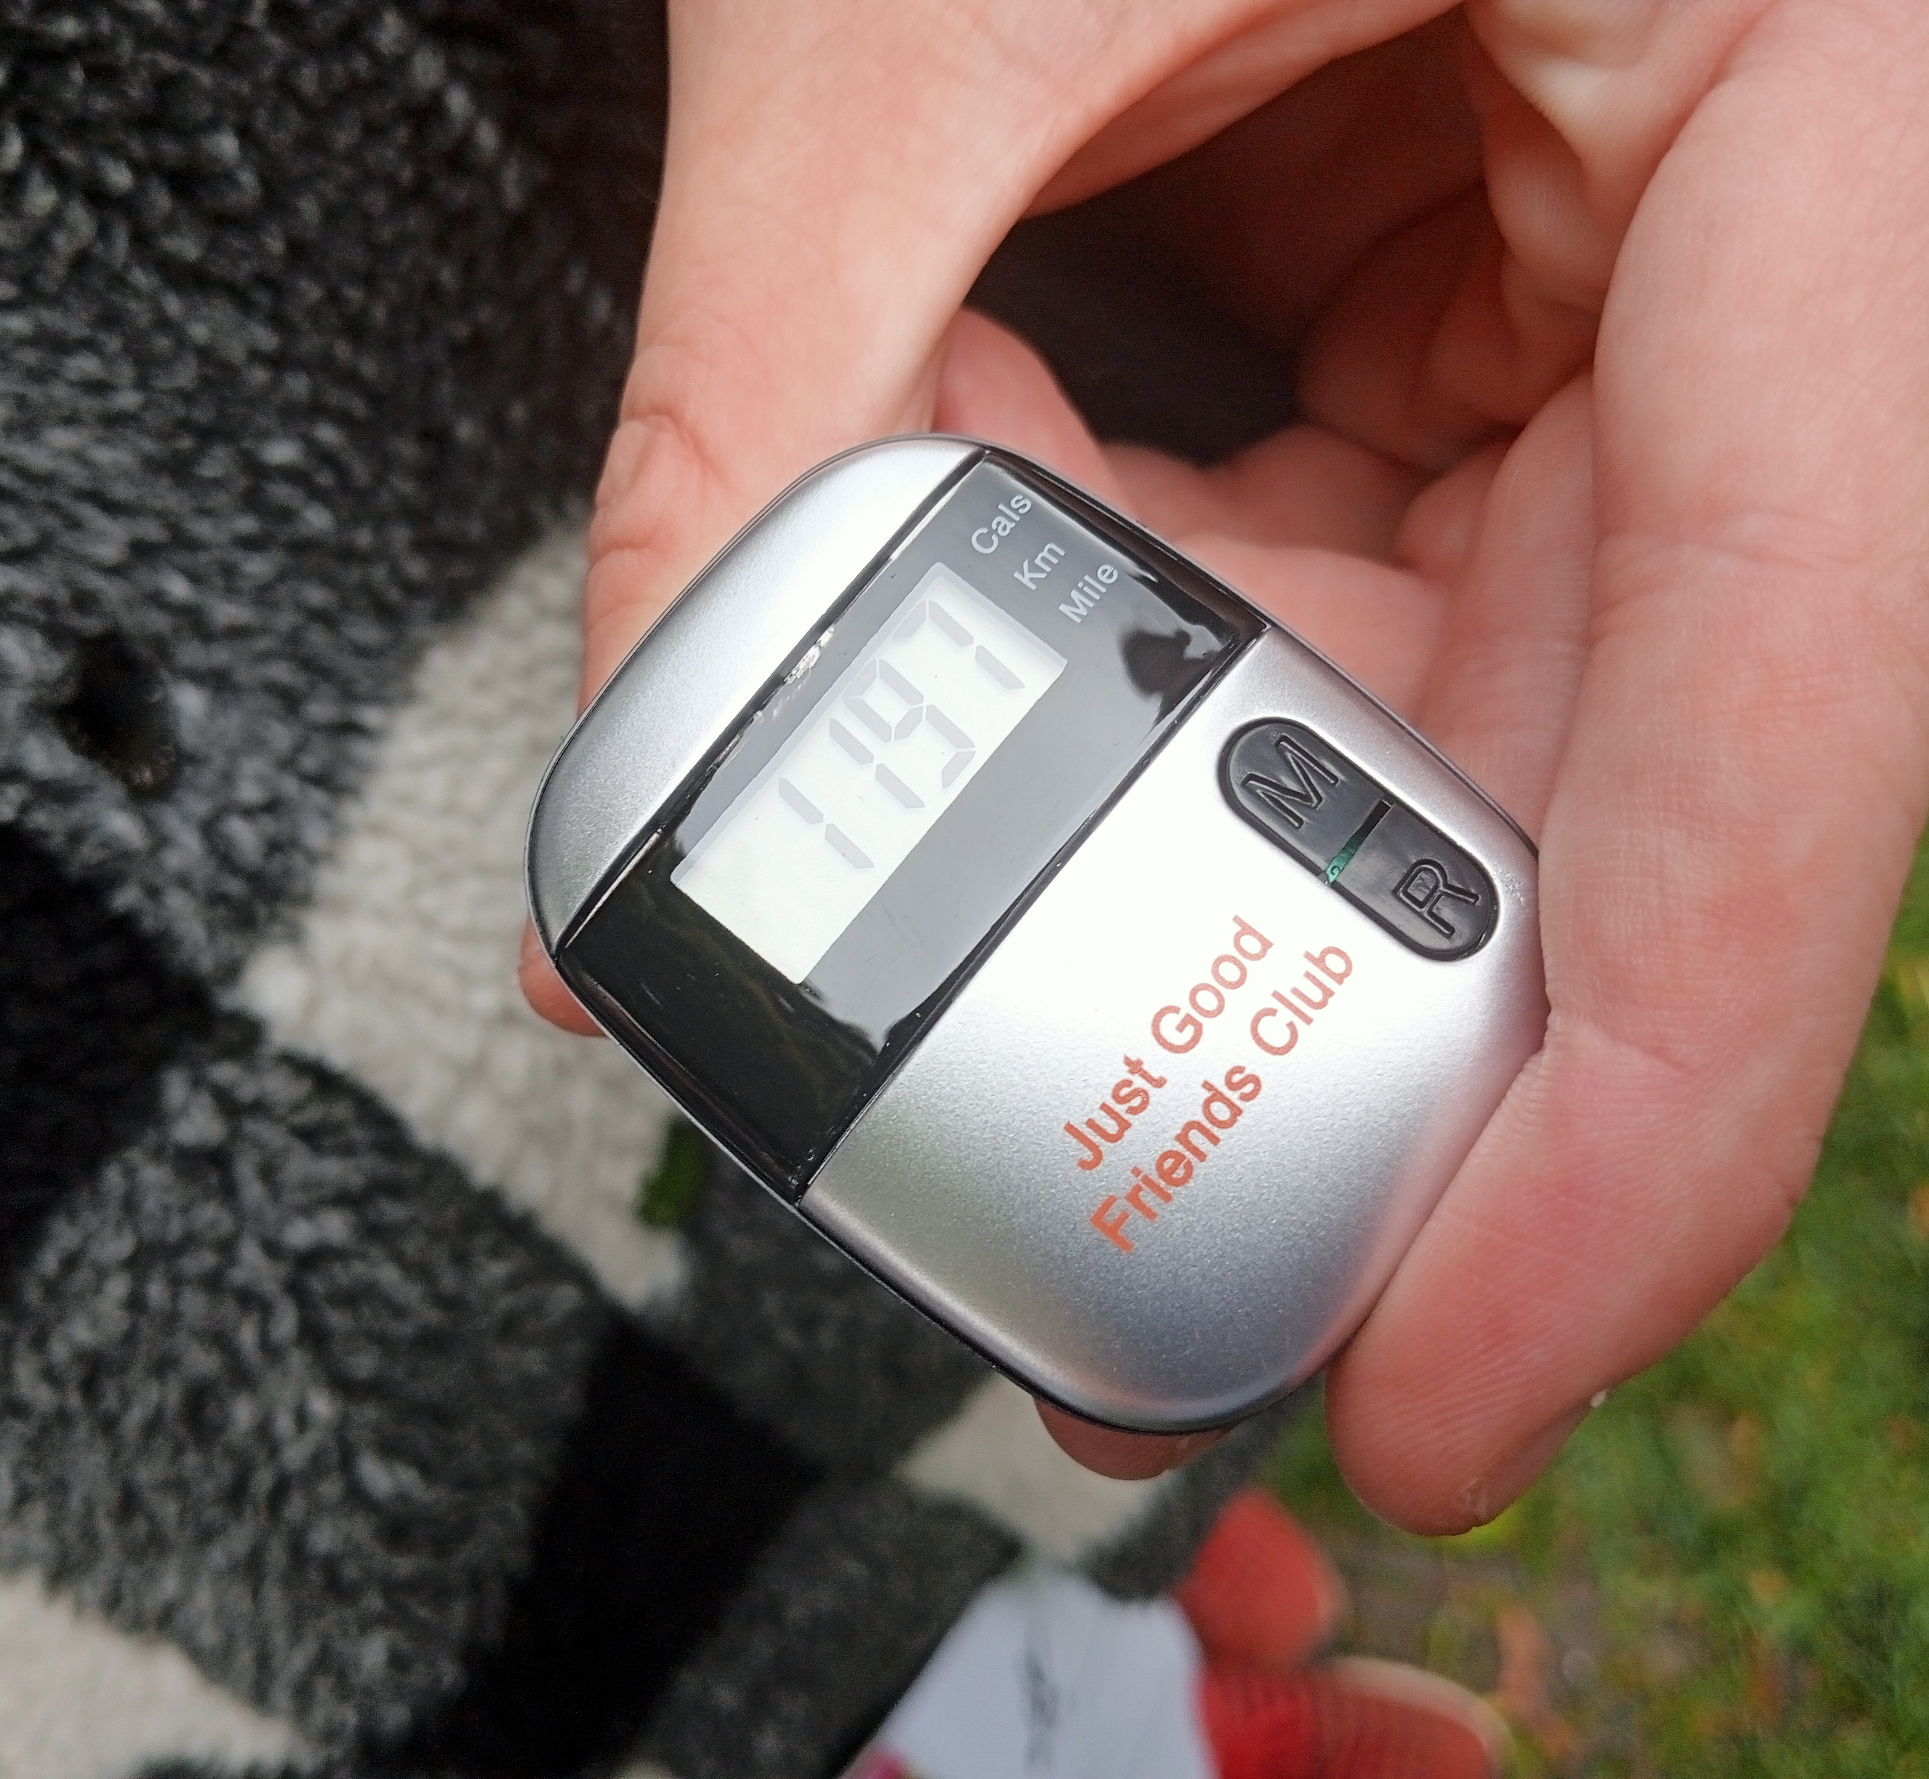
Pedometers were the key to success.

Slide 6
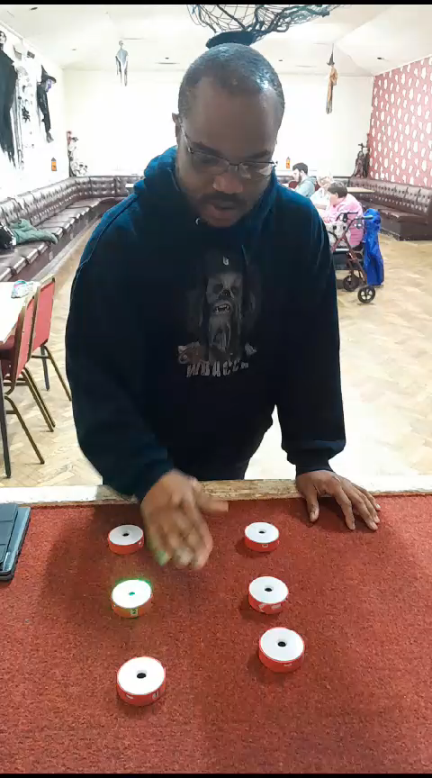
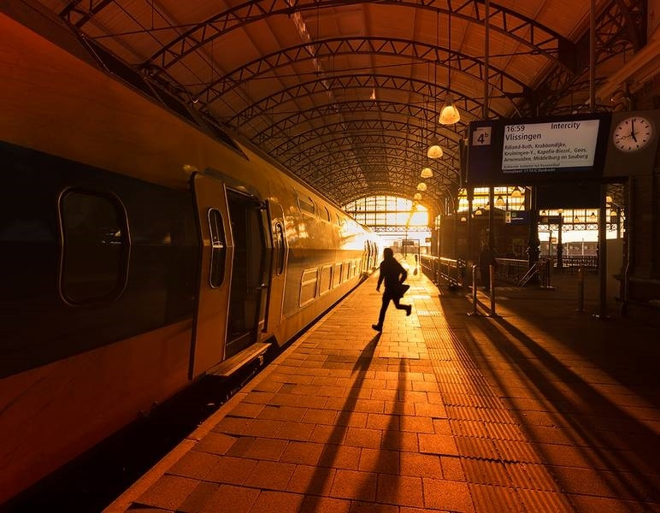
Chair Based Exercise
With funding we were able to buy some chair-based exercise equipment , making our fitness activities more inclusive. Seated peddles means our members that aren't good on their feet rack up the steps too.
The equipment has helped other members with more complex needs.

Slide 7
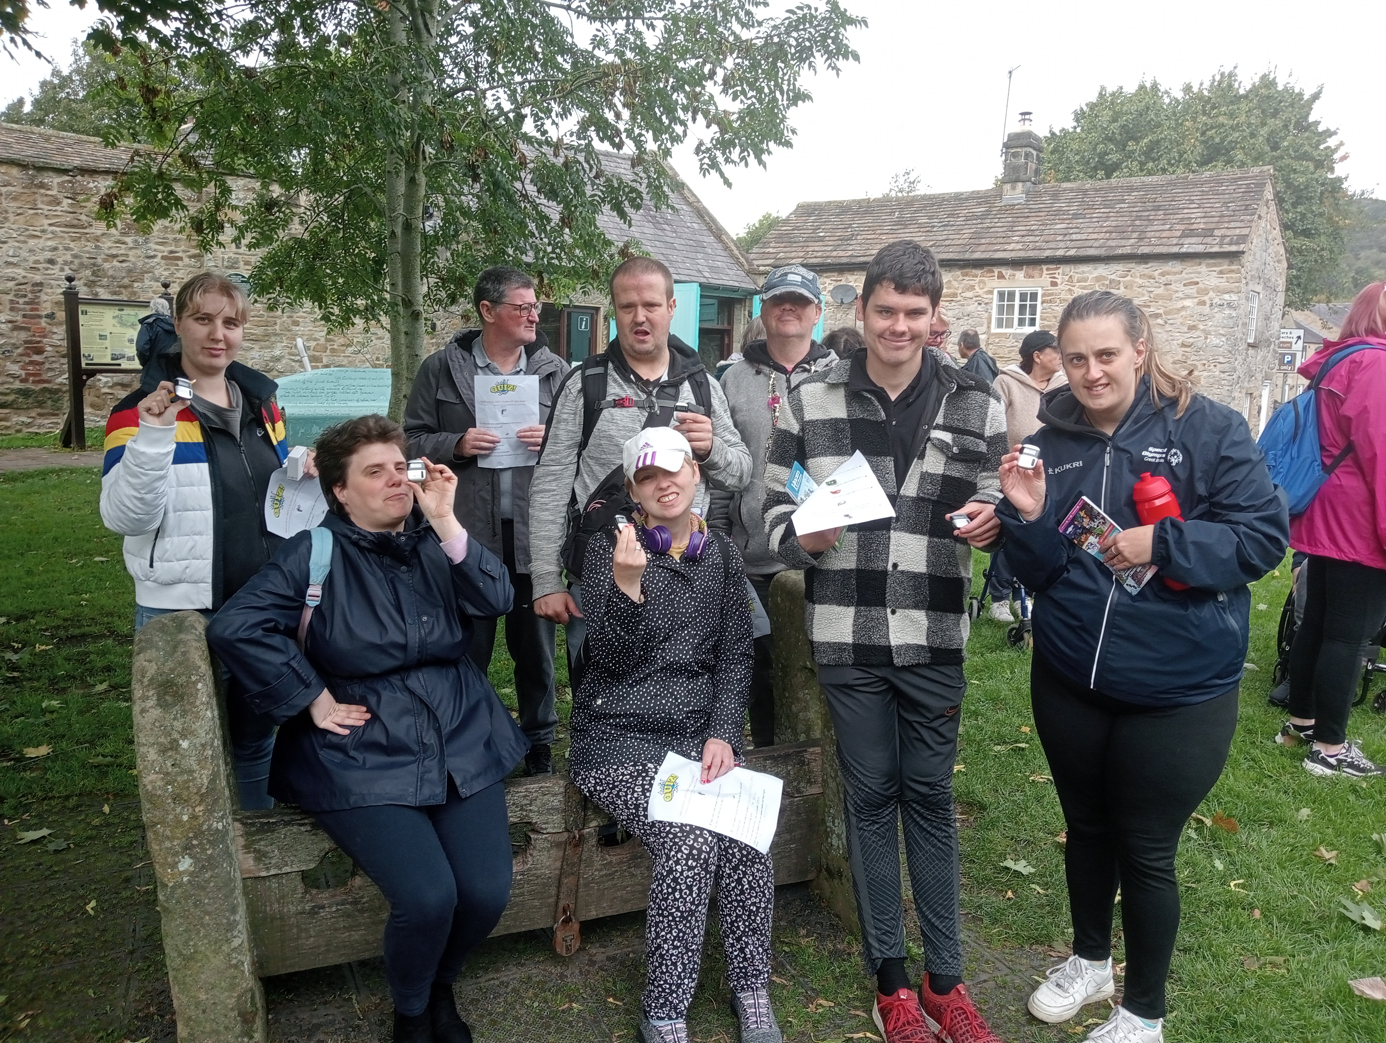
Summary
We found making this activity fun and challenging made our members challenge themselves.
Being part of collective but with the friendly competition between Hubs took this to another level and made it more successful than we could imagine.

