Slide 1
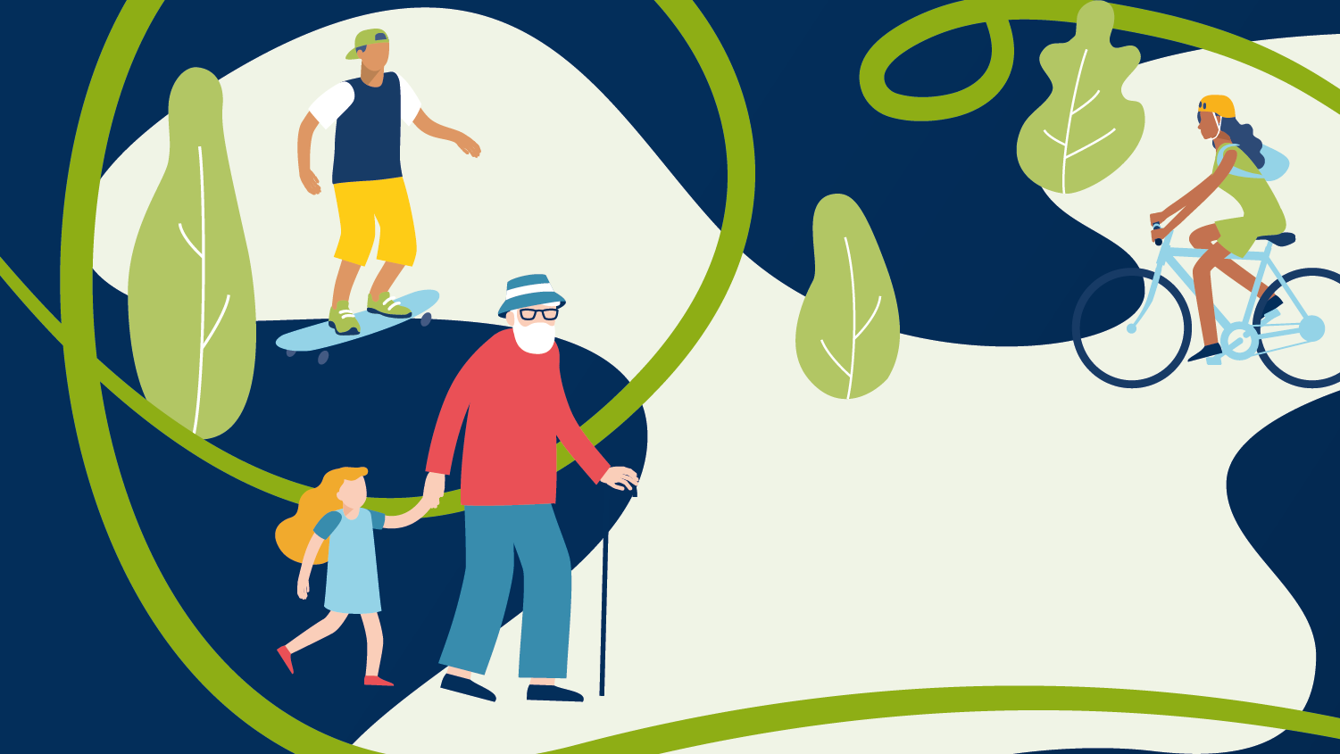

Slide 2


Contents
Population overview
Data at whole population level
Demographic groups
Activities

Slide 3
Population overview Nottinghamshire County Council

Slide 4
Census 2021 – Population
 |  |  |  | England | Nottinghamshire County Council
Total population |  | 2011 |  | 53,012,456 | 785,802
2021 |  | 2021 |  | 56,489,800 | 824,700
Change |  |  |  | 3,477,344 | 38,898
% Change |  |  |  | 6.6% | 5%
Males (15+) | 2011 |  |  | 21,272,695 | 318,864
 | 2021 |  |  | 22,617,600 | 334,700
Change |  |  |  | 1,344,905 | 15,836
Females (15+) | 2011 |  | 2011 | 22,367,751 | 334,182
 | 2021 |  | 2021 | 24,033,600 | 353,300
Change |  |  |  | 1,665,849 | 19,118
Source: Census 2011 and 2021

Slide 5
Census 2021 – Age groups
Age groups | England | Nottinghamshire County Council
2011
0-14 | 9,372,010 | 132,756
15-34 | 14,095,688 | 180,916
35-54 | 14,714,960 | 227,246
55-74 | 10,721,552 | 179,658
75+ | 4,108,246 | 65,226
2021
0-14 | 9,838,700 | 137,200
15-34 | 14,301,300 | 185,800
35-54 | 14,886,100 | 214,000
55-74 | 12,626,500 | 206,700
75+ | 4,837,100 | 81,600
Source: Census 2011 and 2021
Notes:
How the 55+ population has grown
England 17.8%
xx

Slide 6
Projected population growth in Nottinghamshire County Council
The total population of Nottinghamshire County Council is expected to grow by approximately 15.2% over the next 20 years
Within this the 65+ population is expected to grow by 33.4%
Source: ONS 2014, subnational projections
Notes:
Total England population is expected to grow by 12.4% and the over 65 population by 35.2% (between 2022 and 2042)

Slide 7
Activity data at whole population level
CMO guidelines suggest the following expected levels of physical activity each week, categorised by age.
The guidelines suggest:
19-64 year olds should aim to do one of the following:
150 minutes of moderate intensity activity e.g. a brisk walk
75 minutes of vigorous activity e.g. a run
Up to 75 minutes of very vigorous intensity activity e.g. a sprint or stair climbing or a combination of moderate, vigorous and very vigorous activity
Adult CMO guidelines refer to people aged 19+; there are separate guidelines for under 19s. The Active Lives survey (which this pack draws it’s data from) is for people aged 16+.
Over 65 year olds should aim to do one of the following:
150 minutes of moderate intensity aerobic activity (building up gradually from current levels)
75 minutes of vigorous activity (for those who are already regularly active) or a combination of moderate and vigorous activity (to achieve greater benefits)
Of note for this age group: Weight-bearing activities are seen as beneficial, where possible, because they create an impact through the body which helps to maintain bone health

Slide 8
Changes in activity levels in Nottinghamshire County Council
Source: Sport England, Active Lives Adults, Nov 15-16 to Nov 20-21, excluding gardening

Slide 9
Physical activity levels have shifted
Source: Sport England, Active Lives Adults, Nov 15-16 to Nov 20-21, excluding gardening

Slide 10
Most inactive people do nothing
114,000
people
68,000
people
8,000
people
Source: Sport England, Active Lives Adults, Nov 20-21, excluding gardening, Census 2021
Notes:
Population estimates in previous packs have used ONS population estimate data whereas this partnership pack is using the Census 2021
Population estimates are rounded to the nearest 500 so may not total the inactive population on the previous slide

Slide 11
Demographic groups
What to look out for
When we split data by demographic groups we start to see differences
To help understand these inequalities, we need to look at each demographic group to see how they differ
We are able to split the data by:
Gender
Prevalence of limiting illness
Age groups
Socio economic groups

Slide 12
Inactivity by demographic group
Source: Sport England, Active Lives Adults, Nov 20-21, excluding gardening

Slide 13
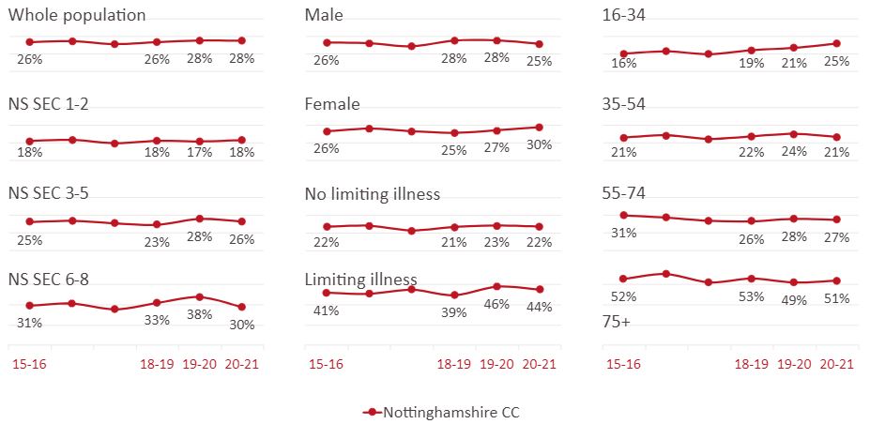
Inactivity by demographic group - trends
Source: Sport England, Active Lives Adults, Nov 15-16 to Nov 20-21, excluding gardening

Slide 14
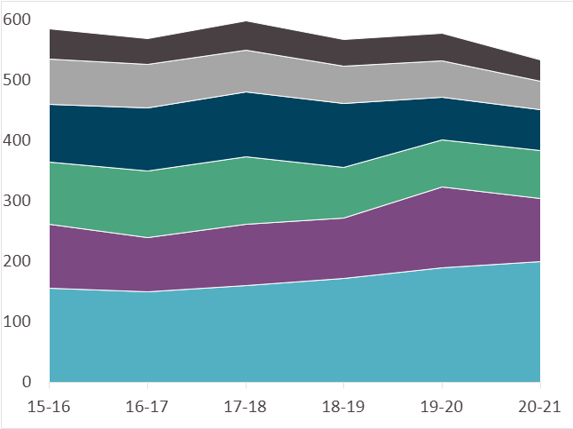
Where people get their active minutes
All cycling, back to pre pandemic levels
Fitness activities, dropped to new low
Walking for travel, dropped to new low
Gardening, dropped from pandemic highs
Traditional sport, signs of recovery
Walking for leisure, continued to increase
Measure: Duration, minutes per week
Source: Sport England, Active Lives Adults, Nov 18-19 to Nov 20-21

